Slide 2
Session 1: Safety and Hazard Recognition

Slide 3
Session One Objectives
When trainees have completed this session, they should be able to do the following:
Describe the importance of safety, the causes of workplace accidents, and the process of hazard recognition and control.
Define incidents and the significant costs associated with them.
Identify the common causes of incidents and their related consequences.
Describe the processes related to hazard recognition and control, including the Hazard Communication (HAZCOM) Standard and the provisions of a safety data sheet (SDS).

Slide 4
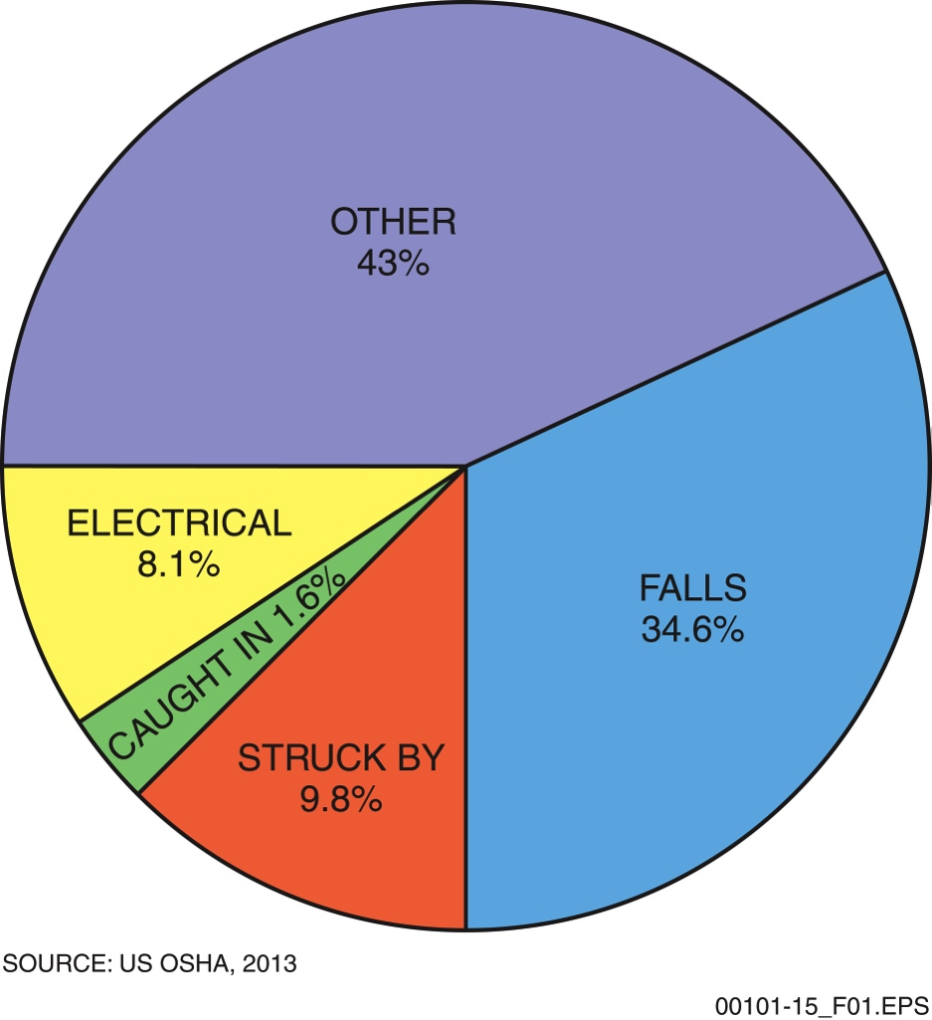
Sections 1.1.1 and 1.1.2 – Safety Incidents
INCIDENT CATEGORIES
Near-miss: An unplanned event or occurrence in which no one was injured and no damage to property occurred, but during which either could have happened. Near-miss incidents are warnings that should always be reported rather than overlooked or taken lightly.
Property damage: An unplanned event that resulted in damage to tools, materials, or equipment, but no personal injuries.
Minor injuries: Personnel may have received minor cuts, bruises, or strains, but the injured workers returned to full duty on their next regularly scheduled work shift.
THE FATAL FOUR
Serious or disabling injuries: Personnel received injuries that resulted in temporary or permanent disability. Included in this category would be lost-time incidents, restricted duty or restricted motion cases, and those that resulted in partial or total disability.
Fatalities: Deaths resulting from unplanned incidents.
Notes:
Explain what an incident is as defined by OSHA and discuss the categories of incidents. Describe the Fatal Four hazard groups and use the chart provided to show how these four types of incidents dominate the construction industry. Explain the various ways in which on-the-job incidents impact workers, their families, and their employers.

Slide 5
Section 1.2.0 – Safety Incidents
CAUSES OF INCIDENTS
Failure to communicate
At-risk work habits
Alcohol or drug abuse
Lack of skill
Intentional acts
Unsafe acts
Rationalizing risks
Unsafe conditions
Housekeeping
Management failure
Notes:
Identify the various causes of on-the-job incidents. Describe how poor communication can affect safety. Describe the types of signs used to communicate safety information on a job site. Explain the difference between information, caution, and danger signs.

Slide 6
Section 1.3.0 – HazCom
Your HazCom Responsibilities
Know where the SDSs are kept on the job site.
Report any hazards you spot on the job site to your supervisor.
Know the physical and health hazards of any hazardous materials on your job site, and know and practice the precautions needed to protect yourself from these hazards.
Know what to do in an emergency, including planned evacuation routes and locations of emergency phones.
Know the location and content of your employer’s written hazard communication program.
Notes:
Explain the terms HAZCOM and Global Harmonization. Use the bulleted list to discuss the responsibilities of employees under HAZCOM. Describe how to evaluate hazards related to equipment and energy release.

Slide 7
Section 1.3.1 – Energy Release
SOURCES OF ENERGY RELEASE
Mechanical
Pneumatic
Hydraulic
Electrical
Chemical
Thermal (heat or cold)
Radioactive
Gravitational
Stored energy
Notes:
Use the bulleted list to discuss the types of incidents that can result in injuries and the types of energy sources that are subject to an undesired release of energy.

Slide 8
Sections 1.3.3 and 1.3.4 – Incident Reporting
All on-the-job injuries or other incidents, no matter how minor, must be reported to your supervisor!
US employers with more than 10 employees are required to maintain a log of significant work-related injuries and illnesses using specific forms and documents.
Notes:
Explain how the risk level of an activity is determined and discuss acceptable vs. unacceptable risks. Explain how risk is mitigated through the use of safety equipment and good safety practices. Explain the need to report all incidents and describe how OSHA and employers use incident reports to help improve safety management.

Slide 9
Section 1.3.5 – Safety Data Sheets
SDS/MSDS
Each product used on a construction site must have an SDS or an MSDS available for immediate use.
The most important things to look for are the specific hazards, personal protection requirements, handling procedures, and first aid information.
Notes:
Provide the trainees with copies of a safety data sheet or refer them to the sample SDS in the text. Discuss the purpose of each section. Explain that the older material safety data sheet (MSDS) form may still be in use to some extent. Briefly discuss the differences between the SDS and MSDS and provide a copy of an MSDS for the trainees to examine.

Slide 10
Wrap Up – Trade Terms
Ground fault
Incidental grounding of a conducting electrical wire.
Hazard Communication Standard (HAZCOM)
The Occupational Safety and Health Administration standard that requires contractors to educate employees about hazardous chemicals on the job site and how to work with them safely.
Hydraulic
Powered by fluid under pressure.
Combustible
Capable of easily igniting and rapidly burning; used to describe a fuel with a flash point at or above 100°F (38°C).
Competent person
A person who is capable of identifying existing and predictable hazards in the surroundings or working conditions that are unsanitary, hazardous, or dangerous to employees, and who has authorization to take prompt corrective measures to eliminate them.
Safety culture
The culture created when the whole company sees the value of a safe work environment.
Safety Data Sheet (SDS)
A document that must accompany any hazardous substance. The SDS identifies the substance and gives the exposure limits, the physical and chemical characteristics, the kind of hazard it presents, precautions for safe handling and use, and specific control measures.
Trench
A narrow excavation made below the surface of the ground that is generally deeper than it is wide, with a maximum width of 15 feet (4.6 m). Also see excavation.
Confined space
A work area large enough for a person to work, but arranged in such a way that an employee must physically enter the space to perform work. A confined space has a limited or restricted means of entry and exit. It is not designed for continuous work. Tanks, vessels, silos, pits, vaults, and hoppers are examples of confined spaces. See also permit-required confined space.
Flammable
Capable of easily igniting and rapidly burning; used to describe a fuel with a flash point below 100°F (38°C).
Management system
The organization of a company’s management, including reporting procedures, supervisory responsibility, and administration.
Occupational Safety and Health Administration (OSHA)
An agency of the US Department of Labor. Also refers to the Occupational Safety and Health Act of 1970, a law that applies to more than more than 111 million workers and 7 million job sites in the US.
Personal protective equipment (PPE)
Equipment or clothing designed to prevent or reduce injuries.
Pneumatic
Powered by air pressure, such as a pneumatic tool.
Respirator
A device that provides clean, filtered air for breathing, no matter what is in the surrounding air.
Notes:
Review the Trade Terms associated with Section 1.0.0 to reinforce the material that was presented. Have the trainees define the term, and then click to have the definitions appear, one at a time.

Slide 11
Next Session…
ELEVATED WORK AND FALL PROTECTION
Read Sections 2.0.0 through 2.4.3. Complete the 1.0.0 and 2.0.0 Section Reviews.

