Slide 2
Session 1: Whole Numbers and Fractions

Slide 3
Session One Objectives
When trainees have completed this session, they should be able to do the following:
Identify whole numbers and demonstrate how to work with them mathematically.
  Identify different whole numbers and their place values.
  Demonstrate the ability to add and subtract whole numbers.
  Demonstrate the ability to multiply and divide whole numbers.
Explain how to work with fractions.
  Define equivalent fractions and show how to find lowest common denominators.
  Describe improper fractions and demonstrate how to change an improper fraction to a mixed number.
  Demonstrate the ability to add and subtract fractions.
  Demonstrate the ability to multiply and divide fractions.

Slide 4
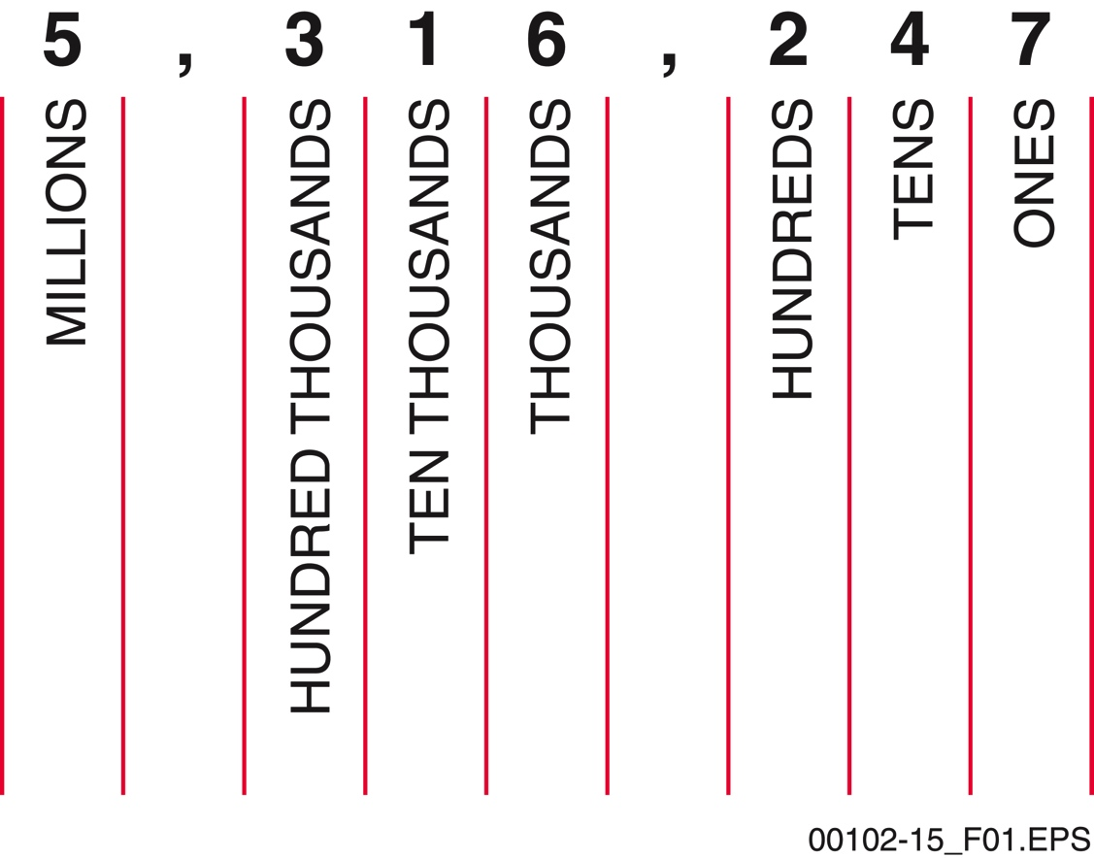
Sections 1.1.0 and 1.1.1 – Place Values
Understanding place value is essential to speaking numbers correctly and accurately.
4. A supervisor estimates that a commercial building will require sixteen thousand, five hundred feet of copper piping to complete all of the restroom facilities. How would you write this value as a whole number?
a. 1,650
b. 16,500
c. 160,500
d. 16,000,500
Notes:
Define digit and place value. Use the figure to demonstrate the assignment of place values. Explain the meaning of positive and negative numbers.
Review the individual study problems related to place values of whole numbers.

Slide 5
Section 1.2.0 – Addition and Subtraction
ADDITION
Step 1 Align numbers vertically.
Step 2 Begin with the column to the right and work towards the left.
Step 3 Carry the 1 over to the next column for numbers over 10. Note that this number may be larger than 1 when adding more than two numbers.
Step 4 Complete the final column on the left.
SUBTRACTION
Step 1 Align numbers vertically.
Step 2 Begin with the column to the right and work towards the left. Borrow a 1 from the next column when the number on the bottom is larger than the one above. Reduce the value of that column by 1 to compensate.
Step 3 Complete the final columns.
Notes:
Define sum. Demonstrate how to align digits for addition. Use the example to demonstrate addition. Explain what difference means in math terms. Demonstrate how to align numbers for subtraction. Use the example to demonstrate subtraction.

Slide 6
Section 1.2.1 – Addition and Subtraction
A general contractor ordered three different sized windows to complete a job on a residential home. She ordered a bow window that cost $874; one 36" × 36" double-hung window that cost $67; and one 36" × 54" double-hung window that cost $93. If she had set aside $1,250 to purchase the windows in her estimate, how much will she have left after buying them?
In calculating a bid for a roof restoration, a contractor estimates that he will need $847 for lumber, $456 for roofing shingles, and $169 for hardware. What is the total cost for the materials portion of the bid?
$1,472.00
$216.00
Notes:
Review the individual study problems related to adding and subtracting whole numbers.

Slide 7
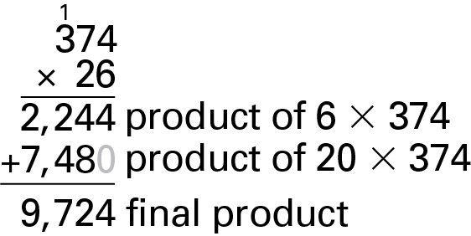
Section 1.3.0 – Multiplication and Division
DIVISION
Set up the problem correctly.
Begin dividing into the number(s) on the left end of the dividend.
Record the resulting multiplier at the top and record the result of the multiplication under the dividend, properly aligned.
Continue the process until the problem is complete. The remainder represents a fraction (part of a whole), in this case 22/24ths.
MULTIPLICATION
Align the digits.
Start at the right. Multiply all top digits, one at a time, by the lower number.
When the result of each multiplication equals or exceeds 10, carry over the left digit and add it to the next product.
If either number in the problem is greater than 10, some addition is required at the end to determine the final answer.
Notes:
Describe multiplication in simple terms and define product. Demonstrate how to align digits for multiplication. Use the example to demonstrate multiplication. Define quotient, dividend, divisor, and remainder. Demonstrate how to write a division problem. Use the example to demonstrate long division.

Slide 8
Sections 1.3.1 and 1.3.2 – The Order of Operations
If one plumbing job requires 45 meters of PVC pipe, and a second job requires 30 meters, how many lengths of pipe will you need if it comes in 6-meter lengths? Remember that you cannot order a partial length of pipe; only orders for whole lengths are generally accepted.
____ lengths of pipe
How much pipe will be left over, assuming there are no errors?
____ meters
6 + 3 × 5 = A
MDAS
Multiplication
Division
Addition
Subtraction
13
3
Notes:
Define an equation and explain the importance of using a specific order of operations. Present the two acronyms to help trainees remember.
Review the individual study problems related to multiplying and dividing whole numbers.

Slide 9
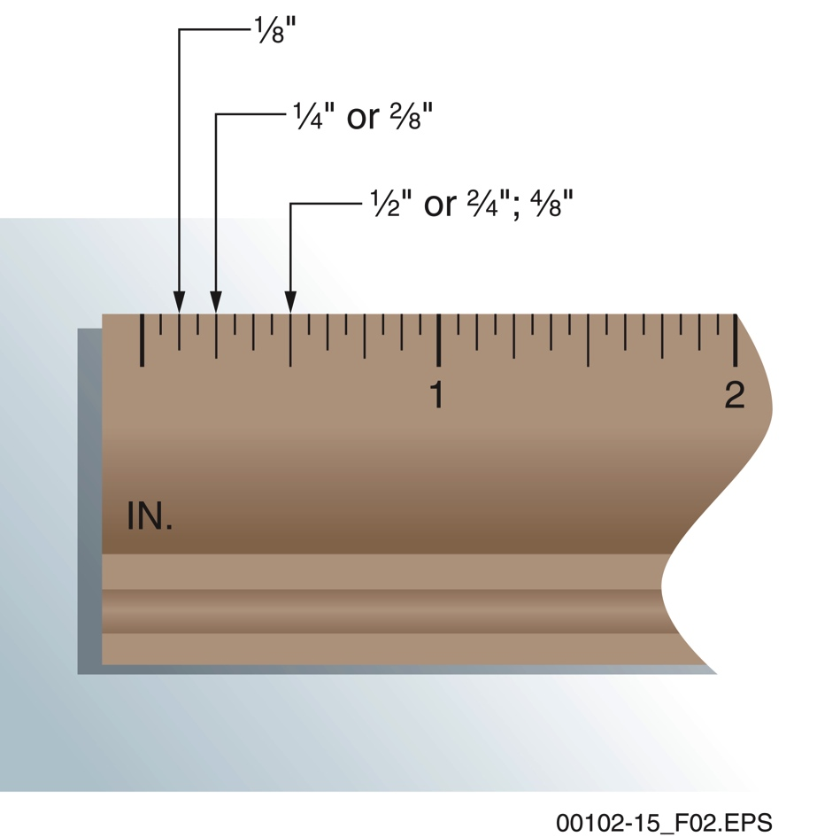
Sections 2.1.0 to 2.1.2 – Fractions
REDUCING TO LOWEST TERMS
Although fractions such as 2/4 and 1/2 are equal, they must share a denominator for addition and subtraction.
Determine the largest number that will divide evenly into both the numerator and denominator. In this case, it is 4. Then divide both by this number.
Notes:
Describe and demonstrate equivalent fractions. Introduce the concept of a lowest common denominator.
Show how math is used to determine a lowest common denominator. Make the connection between these fractions and taking measurements. Show how to change the denominator of fractions.
Demonstrate how to reduce fractions to their lowest terms.

Slide 10
Sections 2.1.3 and 2.1.4 – Fractions
Which is larger?
Find the lowest common denominator for this pair of fractions.
14. 1⁄4 and 3⁄16.
  a. 8
  b. 16
  c. 18
  d. 20
3⁄4 equals how many eighths?
  a. 2⁄8
  b. 4⁄8
  c. 5⁄8
  d. 6⁄8
A common denominator is required for comparison. It does not need to be the lowest common denominator though; common denominators at any level allows for comparison.
Notes:
Present the practical example of comparing fractions to determine which fraction represents a larger value. Point out the advantage of changing fractions to a common denominator for comparison. Review the steps to finding common denominators for fractions.
Review the individual study problems related to finding equivalent fractions.

Slide 11
Section 2.3.0 – Fractions
ADDING FRACTIONS
Find a common denominator; it does not have to be the lowest, but the final answer will need to be converted to its lowest common denominator. Before or after is fine.
Convert the fractions to the same denominator.
Add the numerators only.
Reduce to the lowest common denominator, and then to a mixed number, if necessary.
SUBTRACTING FRACTIONS
Find a common denominator. Like addition, it does not need to be the lowest.
Convert the fractions to the same denominator.
Subtract the numerators only.
Reduce to the lowest terms if necessary.
Notes:
Review the steps in adding and subtracting fractions. Demonstrate how to change a mixed number to an improper fraction for adding and subtracting.

Slide 12
Section 2.3.1 – Fractions
Find the answers to the following subtraction problems. Remember to reduce the differences to the lowest terms.
3⁄8 – 5⁄16 = _____
7. 11⁄16 – 5⁄8 = _____
Find the answers to the following addition problems. Remember to reduce the sum to the lowest terms and change any improper fractions to mixed numbers.
1⁄8 + 4⁄16 = _____
2. 4⁄8 + 6⁄16 = _____
3/8
1/16
7/8
1/16
Notes:
Review the individual study problems related to adding and subtracting fractions.

Slide 13
Section 2.4.0 – Fractions
MULTIPLYING FRACTIONS
No need to find a common denominator!
Multiply the numerators, and then multiply the denominators.
Reduce the resulting fraction to its lowest terms.
DIVIDING FRACTIONS
Again, no need to find a common denominator.
Identify the divisor and invert it. Then change the operation to multiplication.
Now proceed with multiplication and reduce the result to its lowest terms.
Notes:
Point out that common denominators are not needed to multiply and divide fractions. Demonstrate the steps required to multiply and divide fractions.

Slide 14
Section 2.4.1 – Fractions
Find the answers to the following division problems without using a calculator. Reduce the quotients to their lowest terms and change improper fractions to mixed numbers.
3⁄8 ÷ 3 = _____
7. 5⁄8 ÷ 1⁄2 = _____
Find the answers to the following multiplication problems without using a calculator. Reduce the products to their lowest terms and change improper fractions to mixed numbers.
4⁄16 × 5⁄8 = _____
2. 3⁄4 × 7⁄8 = _____
5/32
1/8
1-1/4
21/32
Notes:
Review the individual study problems related to adding and subtracting fractions.

Slide 15
Next Session…
DECIMALS; TAKING MEASUREMENTS
Read Sections 2.0.0 through 4.2.4 to prepare for the next session. Also complete the Section Review for Sections 1.0.0 through 4.0.0.

