Slide 2
Session 1: Common Hand Tools

Slide 3
Session One Objectives
Related Performance Tasks:
Visually inspect the following tools to determine if they are safe to use:
Hammer or demolition tool
Chisel or punch
Screwdriver
Adjustable or non-adjustable wrench
Socket
Torque wrench
Pliers
Wire cutters
Measuring tool
Layout tool
Level
When trainees have completed this session, they should be able to do the following:
Identify and explain how to use various types of hand tools.
Identify and explain how to use various types of hammers and demolition tools.
Identify and explain how to use various types of chisels and punches.
Identify and explain how to use various types of screwdrivers.
Identify and explain how to use various types of non-adjustable and adjustable wrenches.
Identify and explain how to use various types of socket and torque wrenches.
Identify and explain how to use various types of pliers and wire cutters.
Safely and properly use the following tools:
Hammer or demolition tool
Chisel or punch
Screwdriver
Adjustable or non-adjustable wrench
Socket
Torque wrench
Pliers
Wire cutters
Measuring tool
Layout tool
Level
Identify and describe how to use various types of measurement and layout tools.
Identify and explain how to use rules and other measuring tools.
Identify and explain how to use various types of levels and layout tools.

Slide 4
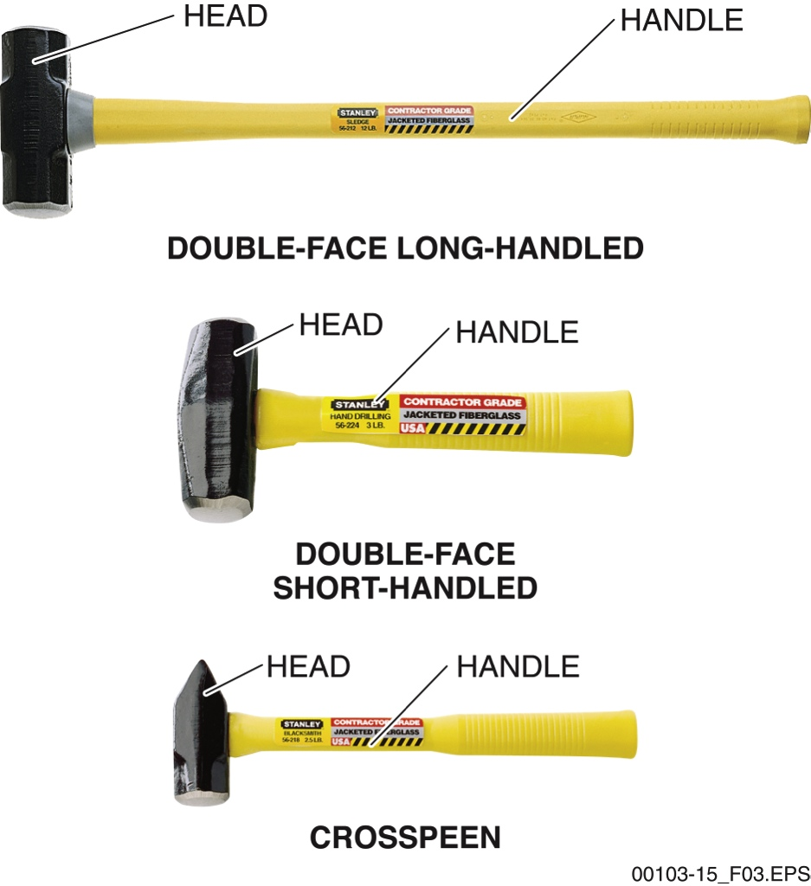
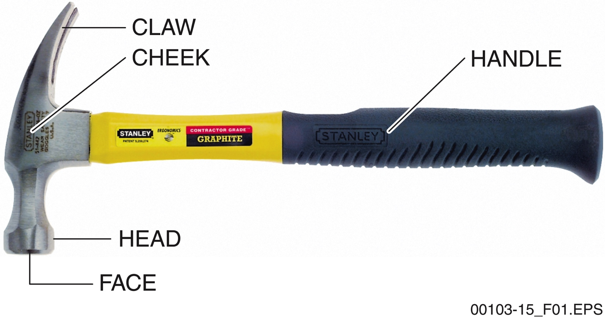
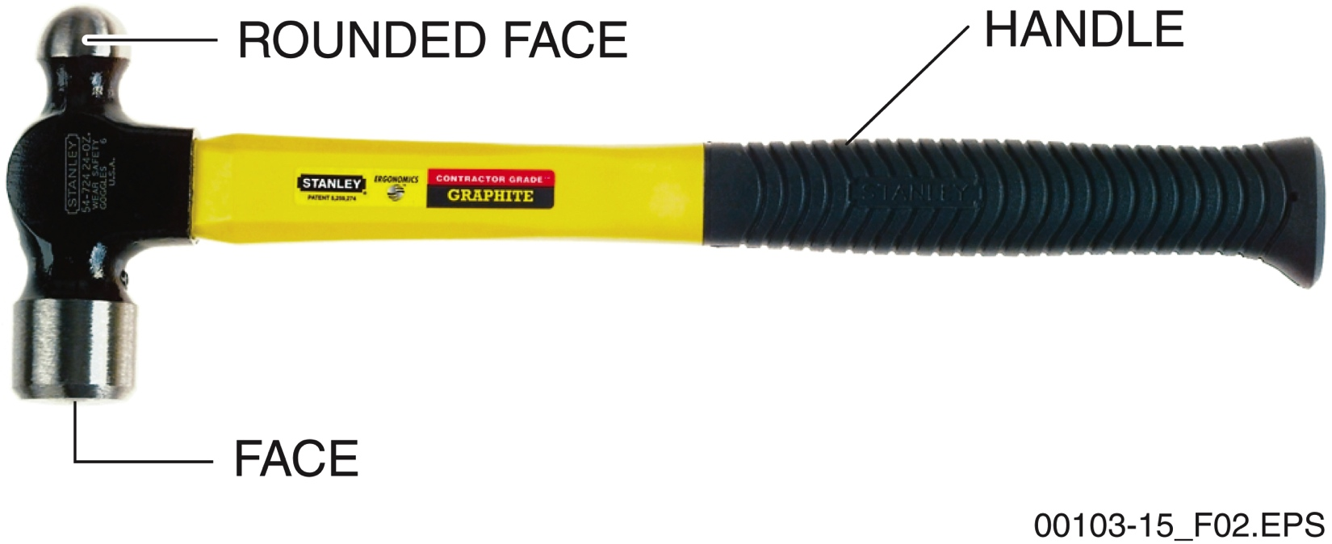
Sections 1.1.0 to 1.1.3 – Hammers
Sledgehammers are heavy and require a lot of effort to swing. Start with lighter blows until you achieve a rhythm.
Hold the hammer with the end of the handle even with the lower edge of your palm. Keep your eye on the nail head!
Ball-peen hammers should not be used to hammer a nail, since the steel is tough but not as hard.
Notes:
Describe the uses of the hammer’s head and claw. Point out the advantage of using a bell-faced hammer. Discuss how to properly grip and swing a hammer. Explain how to hammer a nail and use the claw to pull a nail.
Describe a ball peen hammer. Define peening. Describe differences in the heads and their uses. Talk about the range of weights available. Emphasize that nails should not be driven with this tool and why.
Point out the uses of a sledgehammer. Explain that the shape of the head may vary, and that handle length varies as well. Review the bulleted list of safety and usage information. Emphasize the related warning.

Slide 5
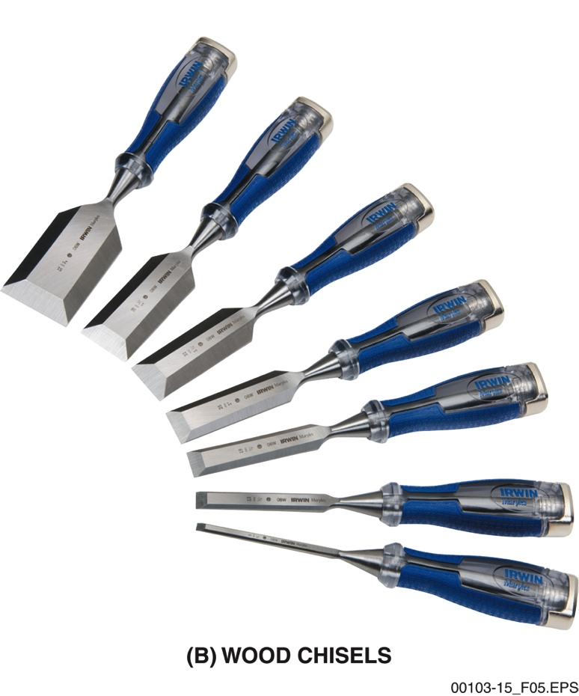
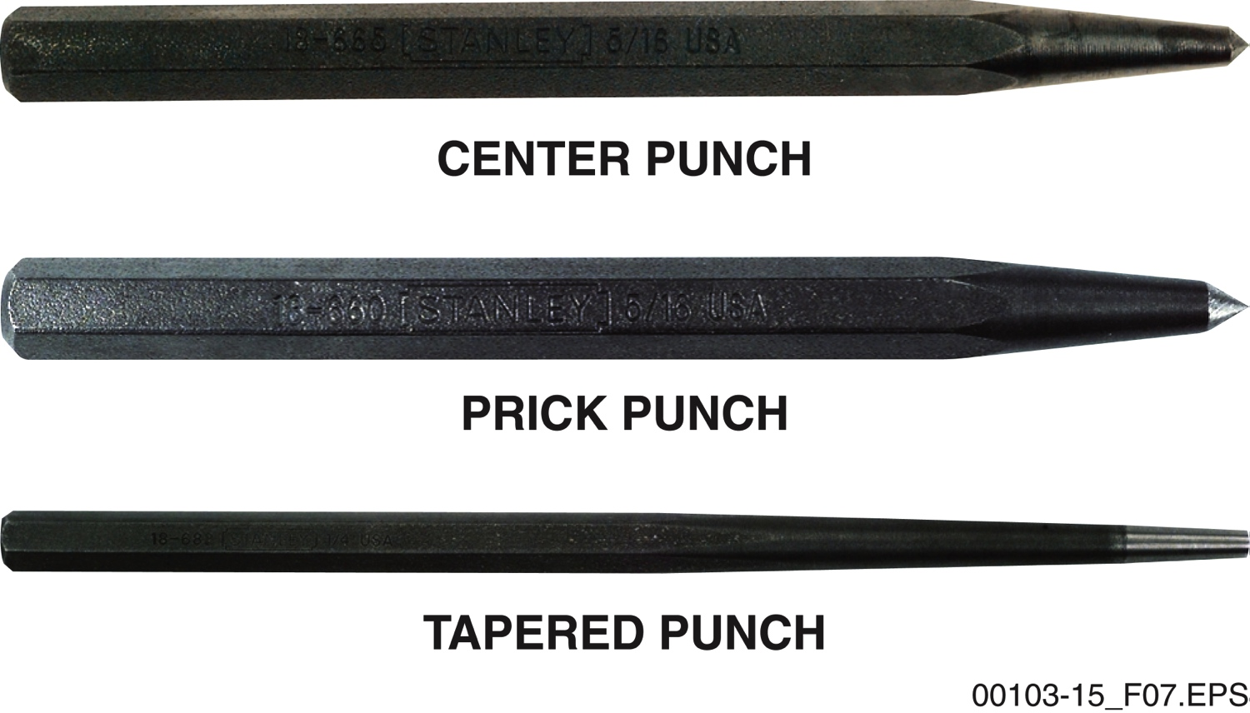
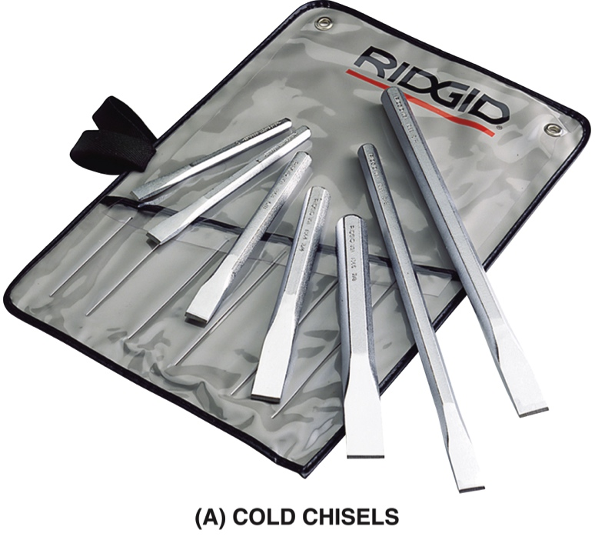
Sections 1.2.1 to 1.2.3 – Chisels and Punches
Cold chisels are designed for working with metal. Many wood chisels are designed to be tapped with a mallet, but others are designed only for use by hand.
Center and prick punches have different tip angles. Pin punches (not shown here) have straight and round shafts and are often used to drive connecting pins out.
Notes:
Compare and contrast cold and wood chisels. Discuss the common types of cold chisels and the purpose of their shapes. Discuss the PPE to be worn when using a cold chisel and explain how to use the tool. Discuss the common types of wood chisels and the purpose of their shapes and styles. Discuss the PPE to be worn when using a wood chisel. Explain how to properly use a wood chisel for the common task of installing a door hinge.
Describe a punch and how it is typically used.
Review the list of safety and maintenance guidelines for chisels and punches.

Slide 6
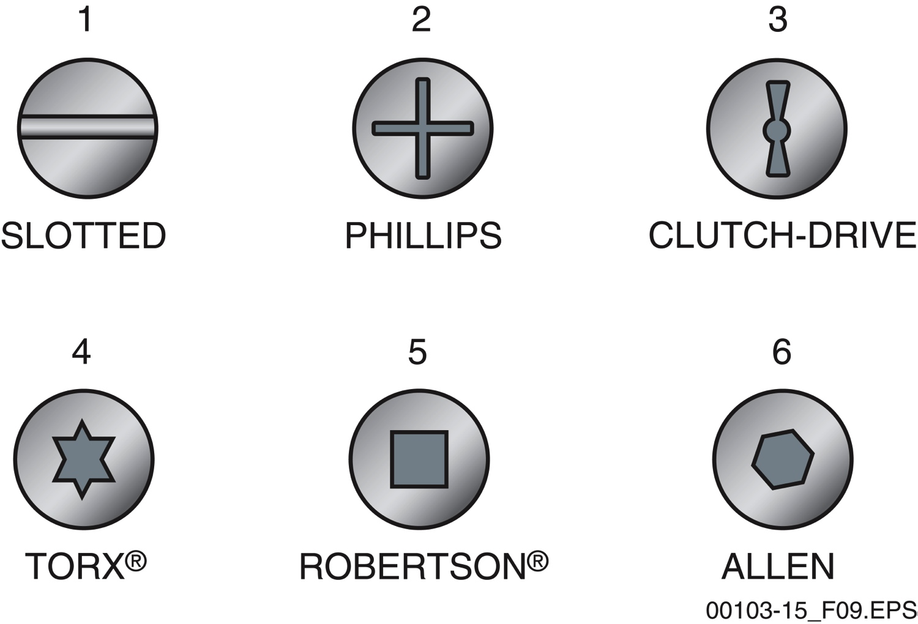
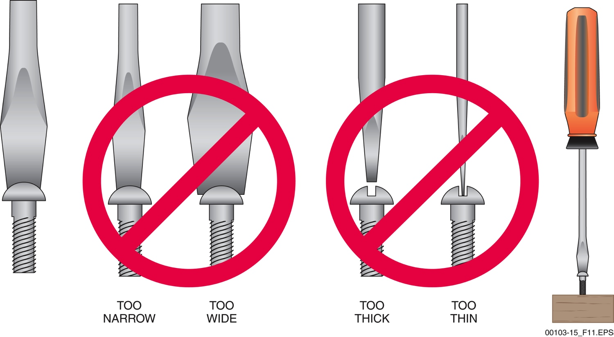
Section 1.3.0 – Screwdrivers
Each screw drive type has its own advantages. Some are popular for woodworking while others have more varied purposes.
A slotted screwdriver that does not fit the screw head is likely to result in damage to the screw and possibly the workpiece as well.
Notes:
Explain that screwdrivers are identified by the type of screw they drive. Introduce the common screw heads. Describe the parts of a screwdriver. Discuss how to properly size the blade of a common screwdriver to the screw head. Explain why screws hold more securely than nails. Point out the consequences of using a screwdriver incorrectly.

Slide 7
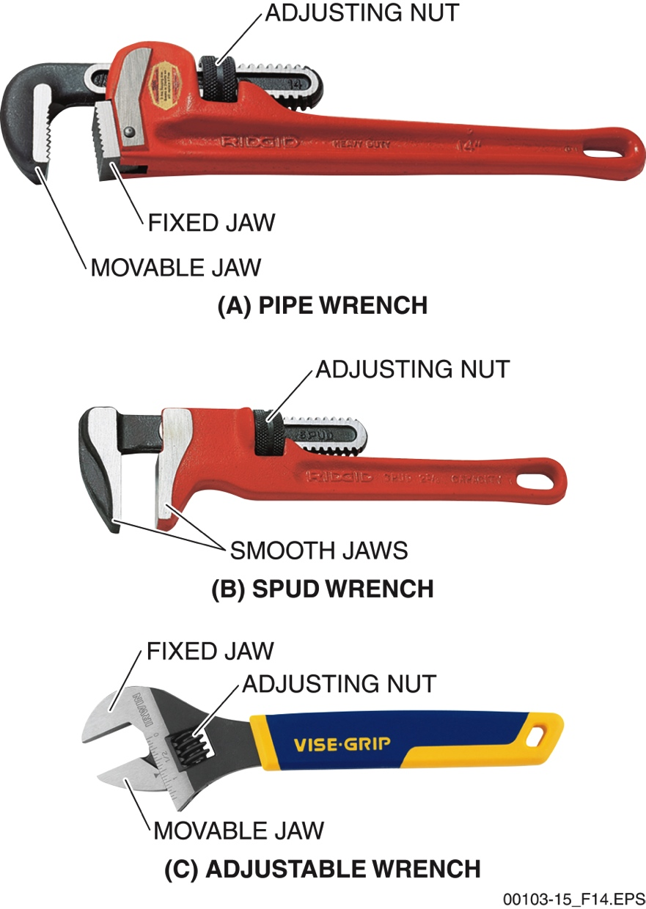
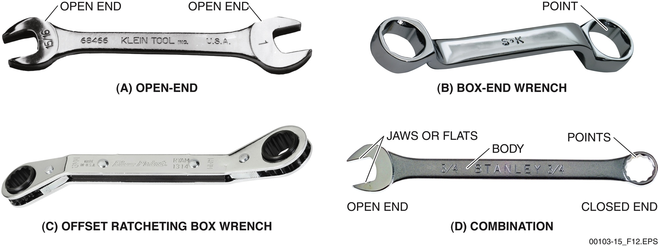
Sections 1.4.1 and 1.4.2 – Wrenches
The correct wrench fits the hardware snug, provides enough leverage for the task, and can be manipulated in the space available.
Spud wrenches are very handy if you are often working with large valve caps or plumbing fixtures.
Notes:
Describe the characteristics of non-adjustable and striking wrenches. Discuss the parts of open-end and box wrenches. Describe the combination wrench. Discuss the use of striking wrenches. Explain what happens when the incorrect wrench size is used on a fastener.
Describe the characteristics and uses of adjustable wrenches. Show trainees the difference between common adjustable wrenches, pipe wrenches, and spud wrenches. Explain how to properly adjust and use an adjustable wrench. Emphasize that stress should be applied to the fixed jaw. Emphasize the warning and point out that wrenches should always be pulled toward the body rather than away.

Slide 8
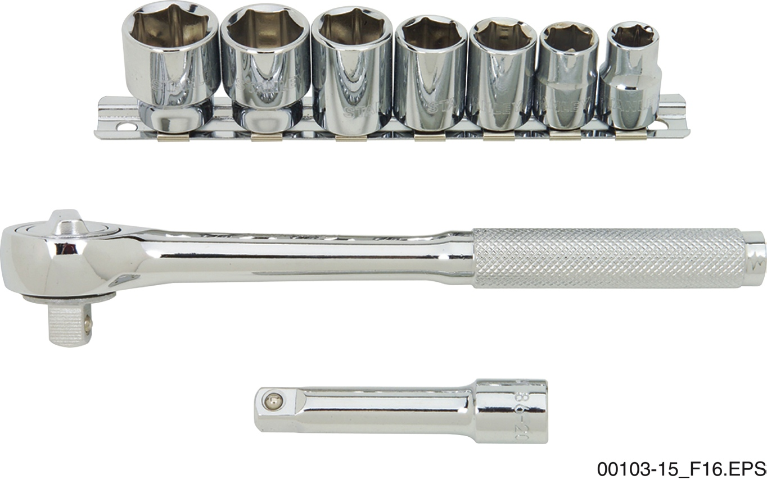
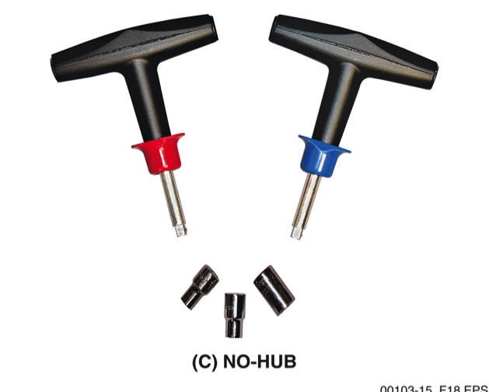
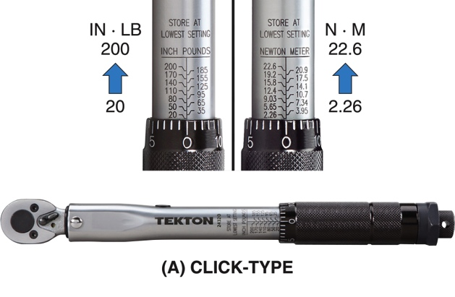
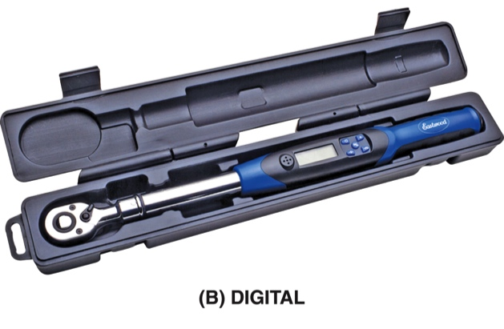
Sections 1.5.1 and 1.5.2 – Sockets
Sockets and ratchet drives are very popular due to their versatility and speed.
Torque wrenches allow the user to apply a specific amount of twisting power to the hardware.
Some digital models can hold settings and torque events in memory.
Notes:
Describe the characteristics of sockets. Discuss the types of handles used to drive a socket. Discuss the differences in the number of points. Mention that 6-point sockets provide better grip and surface contact. Point out the characteristics of a ratcheting handle. Explain how to properly use sockets and ratchets.
Explain when torque wrenches are used. Discuss both Imperial and metric torque values. Discuss how each type of torque wrench is used and for what purpose. Emphasize that torque wrenches should not be used for any type of disassembly work.

Slide 9
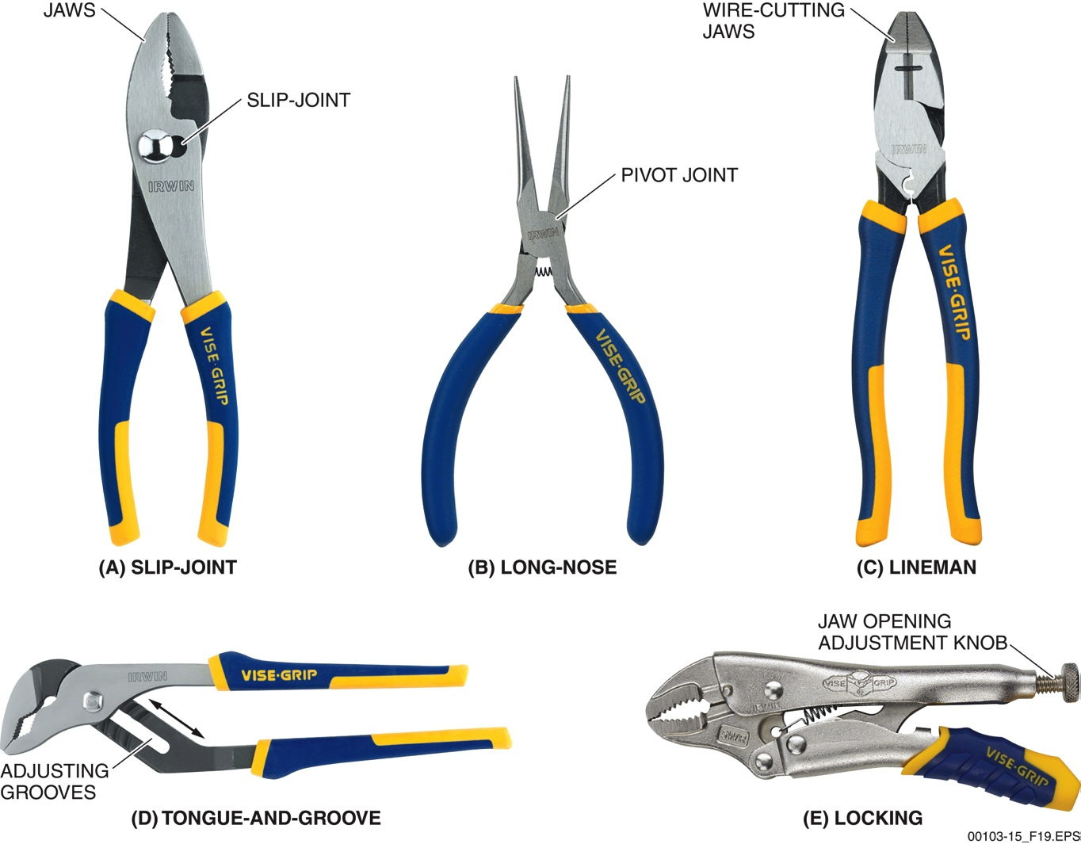
Sections 1.6.1 to 1.6.5 – Pliers
Each type of plier and jaw shape is best for specific uses. Locking pliers can free one hand by standing in as a clamp.
Notes:
Discuss the characteristics and uses for slip-joint pliers. Explain how to properly use them.
Discuss the characteristics and uses for long-nose or needle-nose pliers. Point out that some have jaws for cutting small wire. Explain how to properly use them.
Discuss the characteristics and uses for lineman pliers. Explain how to properly use them. Emphasize that the cut end of the wire should point down.
Describe tongue-and-groove pliers. Explain how to properly use them.
Describe locking pliers and talk about the various styles. Explain how the locking feature makes them extremely valuable on the job.

Slide 10
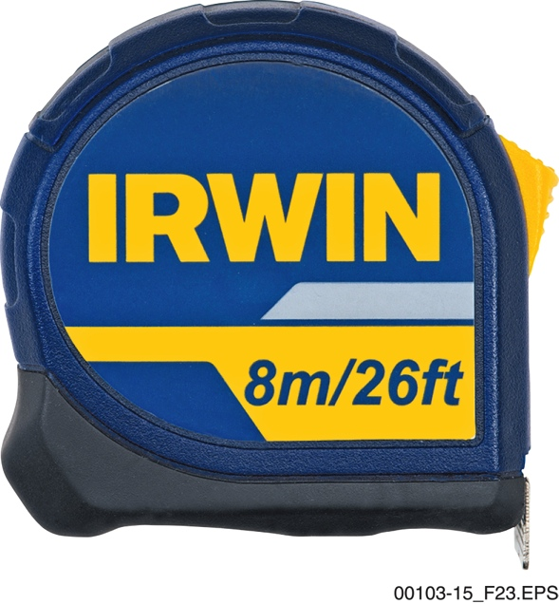
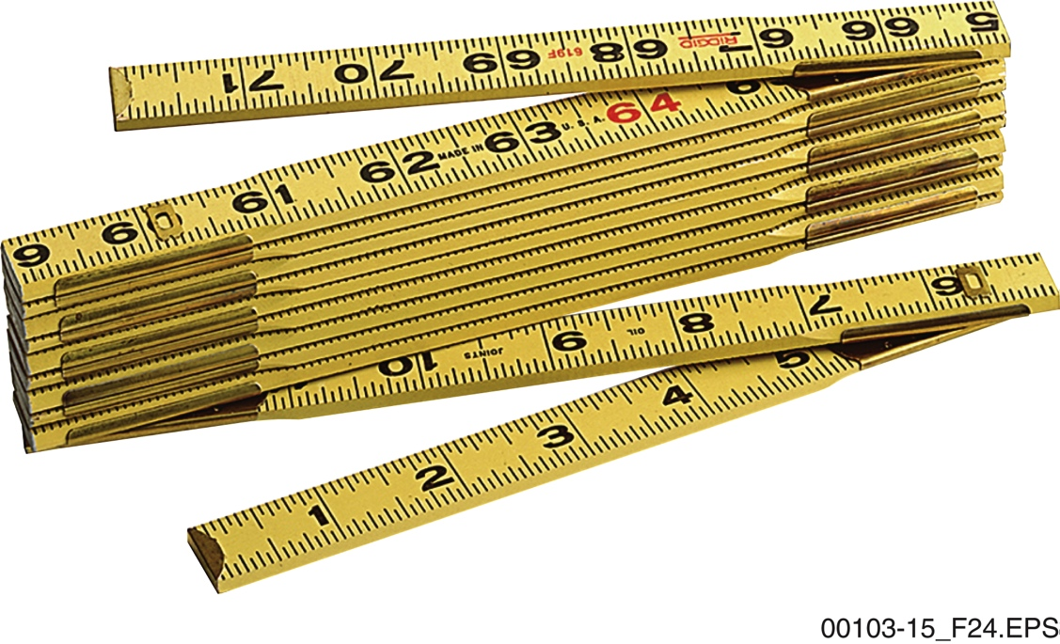
Sections 2.1.2 and 2.1.3 – Tape Measures
Tape measures, or measuring tapes, are great for measurements for a range of lengths. Folding rules are usually 6 feet or 2 meters long and remain rigid, which has its advantages as well.
Notes:
Discuss the measurement markings on a tape measure. Explain the concave shape and how it is used.
Discuss the measurement markings on a wooden folding rule. Explain why its stiffness is an advantage. Discuss the potential differences in standards among countries using the metric system.

Slide 11
Section 2.2.1 – Level Use
Notes:
Describe the characteristics of a spirit level. Using the figure, explain how to read the vials for level and plumb readings.

Slide 12
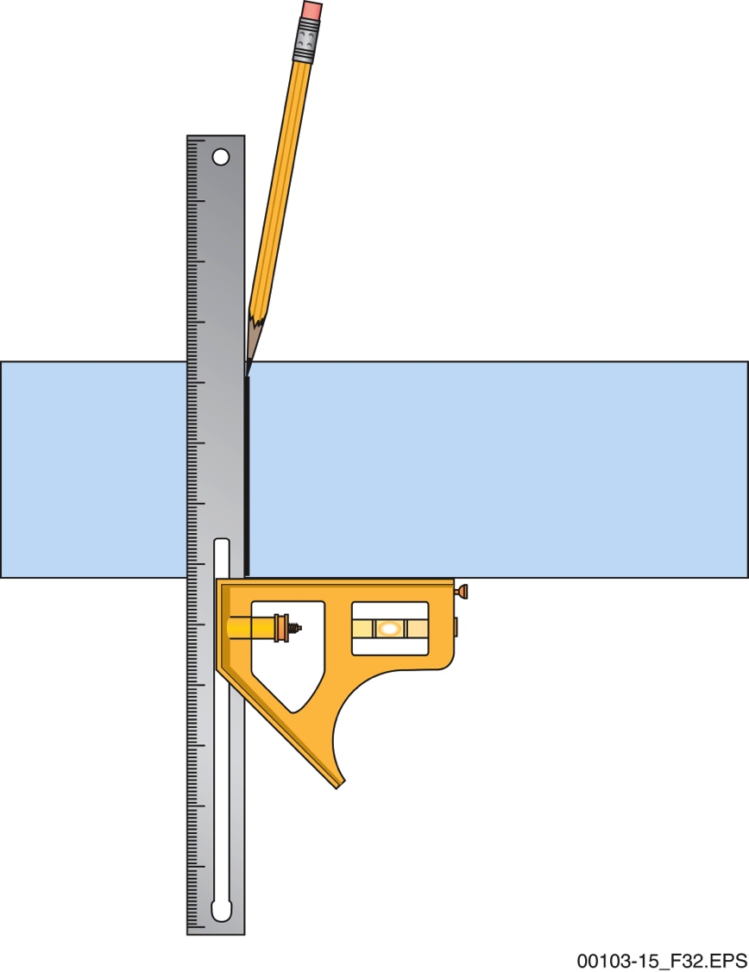
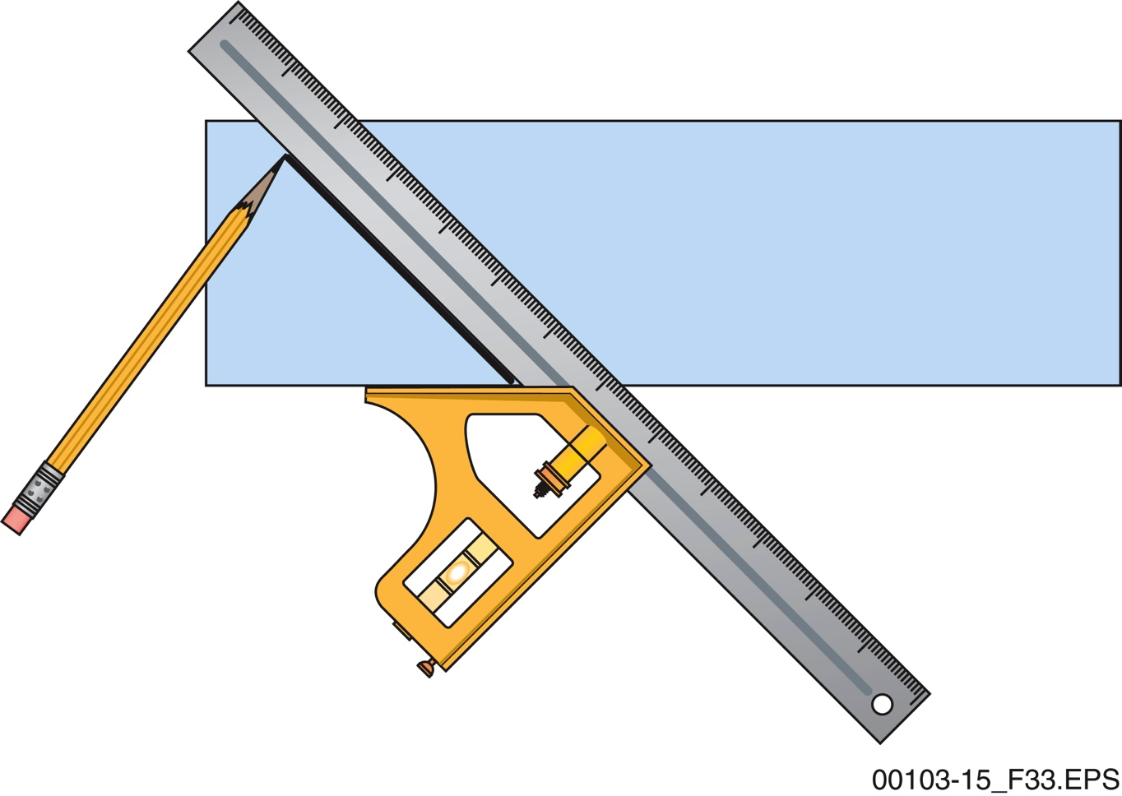
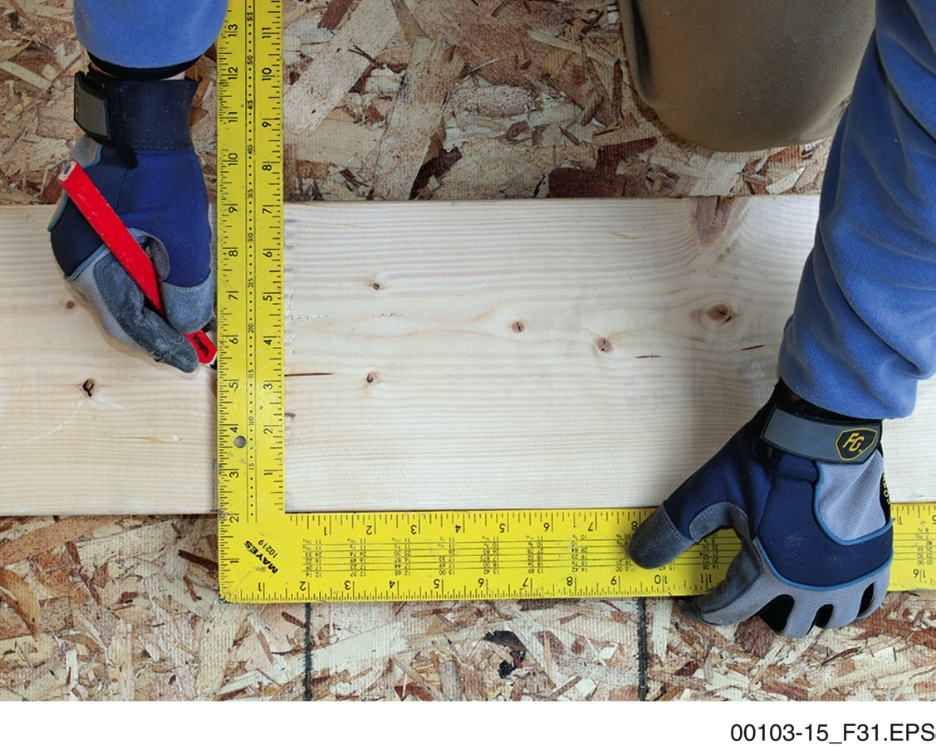
Section 2.2.5 – Squares
The combination square can mark 90-degree angles and …
A pipefitter’s square looks like a carpenter’s square from a distance, but the tables and formulas marked on it are different. They are best for large stock and checking framing.
…45-degree angles. It is limited somewhat by its size and design to scribing lines rather than checking framing for a square condition.
Notes:
Review the various types of squares. Discuss the uses for carpenter’s squares. Describe the measurement markings, tables, and formulas shown on the square. Describe the different combinations of a rafter angle square. Discuss the uses of a rafter angle square. Point out that the try square is typically used for woodworking. Discuss the uses for a try square. Explain the components of a combination square and their purposes. Describe how to mark a 90-degree and a 45-degree angle.

Slide 13
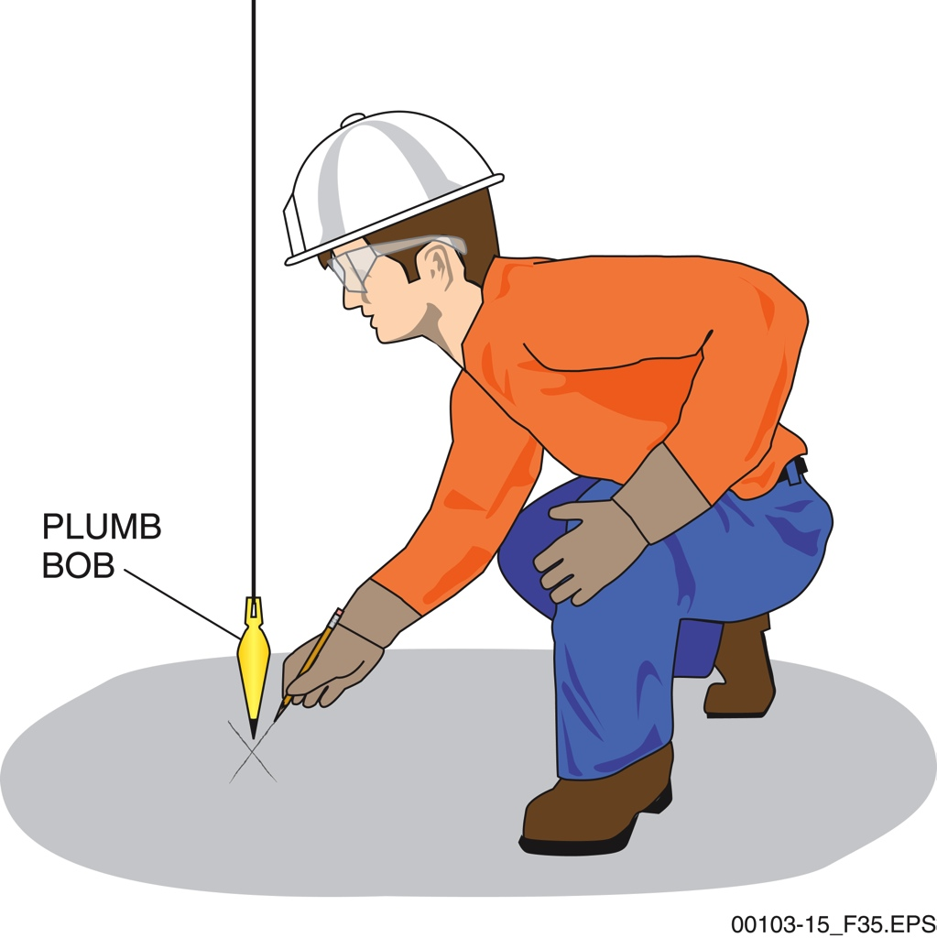
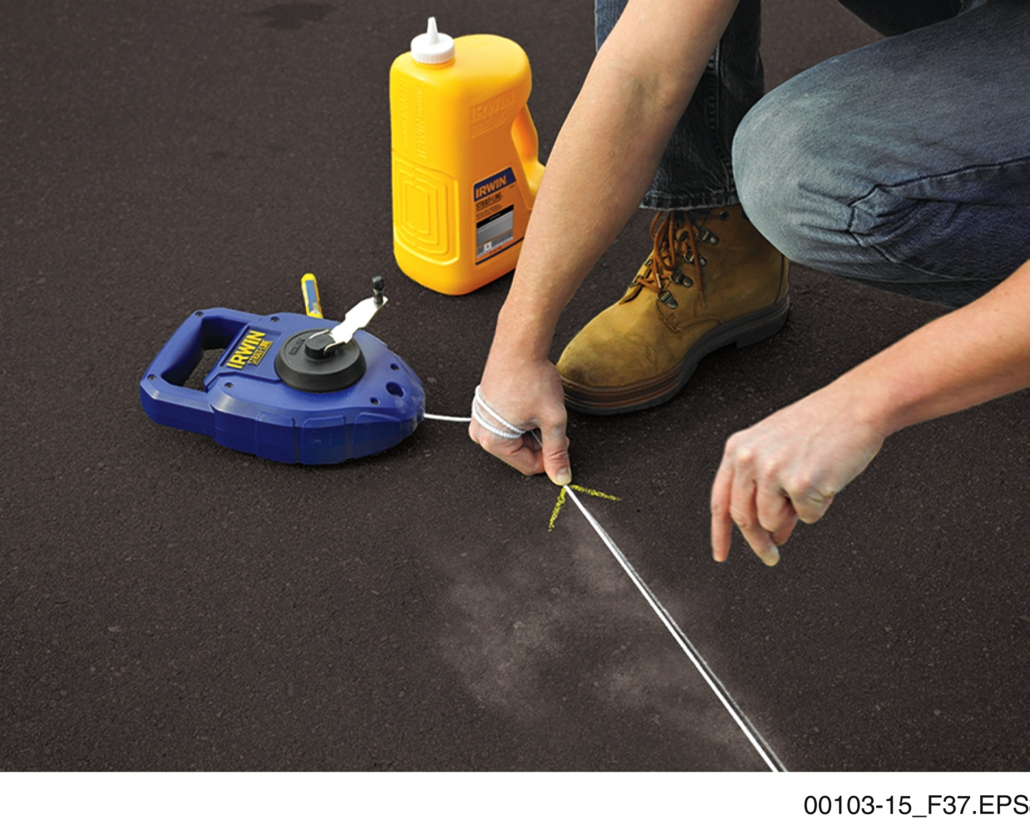
Sections 2.2.6 to 2.2.8 – Plumb Bobs and Chalk Lines
Plumb bobs can identify a point directly beneath another point. Once this point is identified,…
… a chalk line can be used to place a straight line between points.
Notes:
Explain the purpose of a plumb bob. Point out the common weights. Review the steps on how to properly use a plumb bob.
Explain the function of a chalk line and its components. Mention that some chalk lines are also designed to serve as a plumb bob. Describe how to snap a chalk line. Emphasize that damp chalk is unusable; the chalk must be kept exceptionally dry.

Slide 14
Next Session…
CUTTING and SHAPING TOOLS; OTHER COMMON HAND TOOLS
Read Sections 3.0.0 through 4.3.1. Complete the Section Reviews for all module sections.

