Slide 2
Session 2: Cutting and Shaping Tools; Other Common Hand Tools

Slide 3
Session Two Objectives
When trainees have completed this session, they should be able to do the following:
Identify and explain how to use various types of cutting and shaping tools.
Identify and explain how to use handsaws.
Identify and explain how to use various types of files and utility knives.
Identify and explain how to use other common hand tools.
Identify and explain how to use shovels and picks.
Identify and explain how to use chain falls and come-alongs.
Identify and explain how to use various types of clamps.
Related Performance Tasks:
Visually inspect the following tools to determine if they are safe to use:
Hand saw
File
Utility knife
Shovel or other earth tool
Chain fall or hoist
Clamps
Safely and properly use the following tools:
File
Utility knife
Shovel or other earth tool
Chain fall or hoist
Clamps
3. Make a straight, square cut in framing lumber using a crosscut saw.

Slide 4
Section 3.1.0 – Saws
Notes:
Compare and contrast various types of saws. Explain that some saws have a unique purpose and application. Define tpi and how it affects the cut quality.

Slide 5
Section 3.1.1 – Crosscutting Lumber
Using a Hand Saw
Mark the cut with a square. Mark one side of the line on which the saw cut should be made.
Support and secure the workpiece. Wear gloves.
Place the saw teeth against the wood on the side away from you. Align the edge of the blade teeth with your cut line.
With the saw handle near the workpiece and at roughly a 45-degree angle, begin drawing the saw up and back towards you slowly. Use the gloved thumb of your free hand as a saw guide.
After a slight kerf is formed by drawing the saw back, push the saw forward. This requires more force since it is a true cutting stroke.
Continue sawing in this manner, with more force applied when the saw is moving away from you. No need to ride or push the saw down into the wood. A sharp saw will take care of itself.
Maintain the 45-degree angle and keep the saw blade aligned to the mark. Watch for movement of the workpiece as the cut progresses that can cause the kerf to close on the saw and bind it.
Notes:
Explain how handsaws are classified. Discuss how the design of the saw teeth affects the kerf. Describe how a crosscut saw cuts and its characteristics. Review the list and discuss how a crosscut saw is used. Describe how a ripsaw cuts in comparison to a crosscut saw. Explain how to use a ripsaw. Remind trainees that they will cut lumber for a Performance Task.

Slide 6
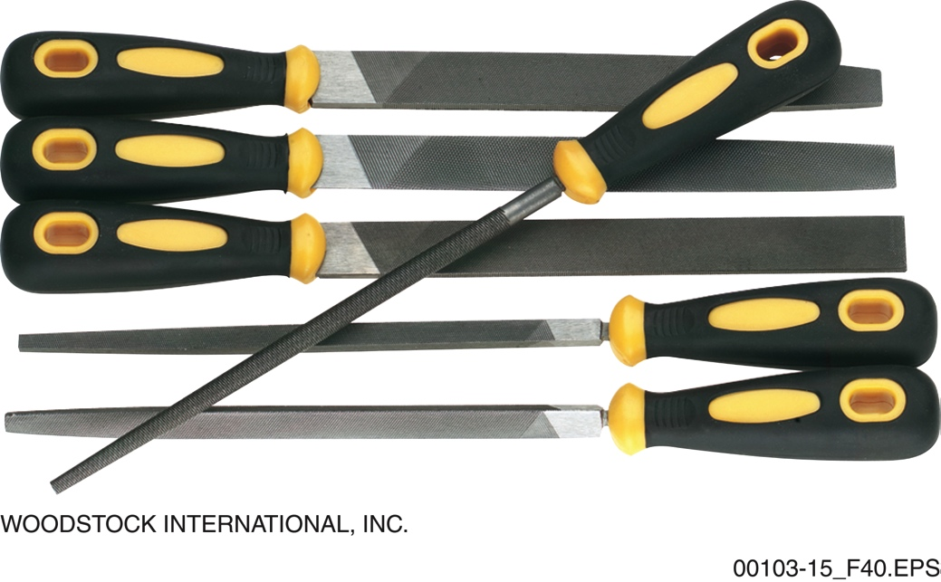
Section 3.2.1 – Files
Never use a file without a handle. It is unsafe and the file cannot be properly controlled. Gloves should always be worn as well.
Notes:
Explain the purposes of files and rasps. Describe the different types of files, rasps, and handles while discussing their uses. Explain the difference between a file and a rasp. Show the figure to discuss the parts of a file.

Slide 7
Section 3.2.1 – Files
Rasp-cut files work very poorly on metal and should be used on wood only. Rasps may also be made from a softer metal that is not hard enough for effective metal cutting.
Notes:
Explain how to choose the correct files and rasps for the type of material and task. Discuss the various profiles and surface textures available. Use the table to review the types and uses of files.

Slide 8
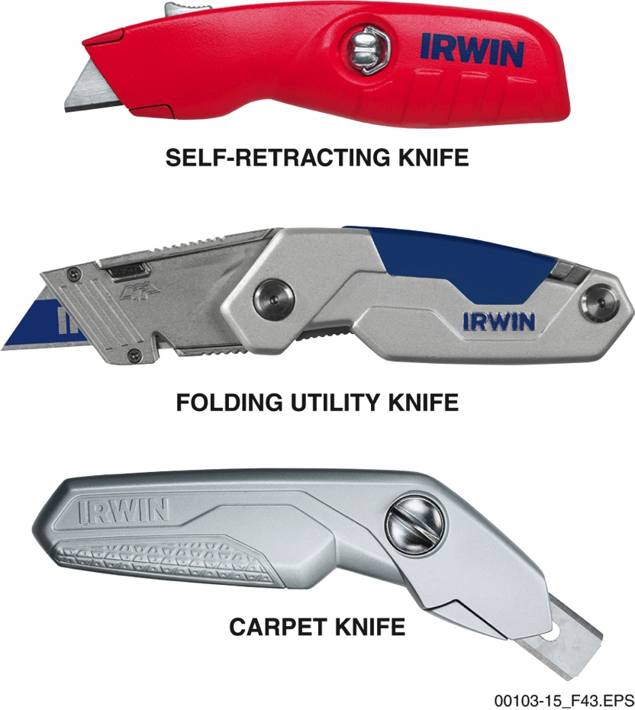
Section 3.2.2 – Utility Knives
Utility knives have a high rate of injury and can inflict significant damage on the body in an instant. Use them with great care. Self-retracting models may be required on the job site.
Notes:
Explain the typical uses for utility knives. Describe the characteristics of each type. Point out that self-retracting utility knives are commonly used for safety purposes. Discuss the safe and proper use of a utility knife. Emphasize the importance of wearing gloves and retracting the blade any time cutting is not in progress.

Slide 9
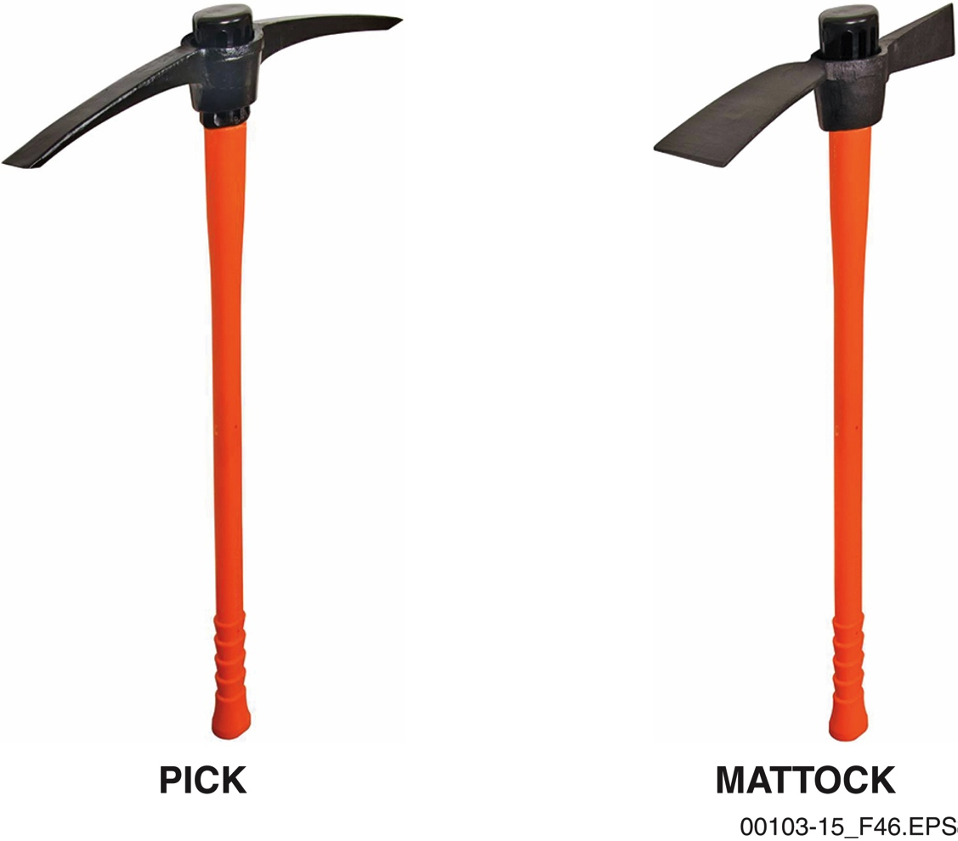
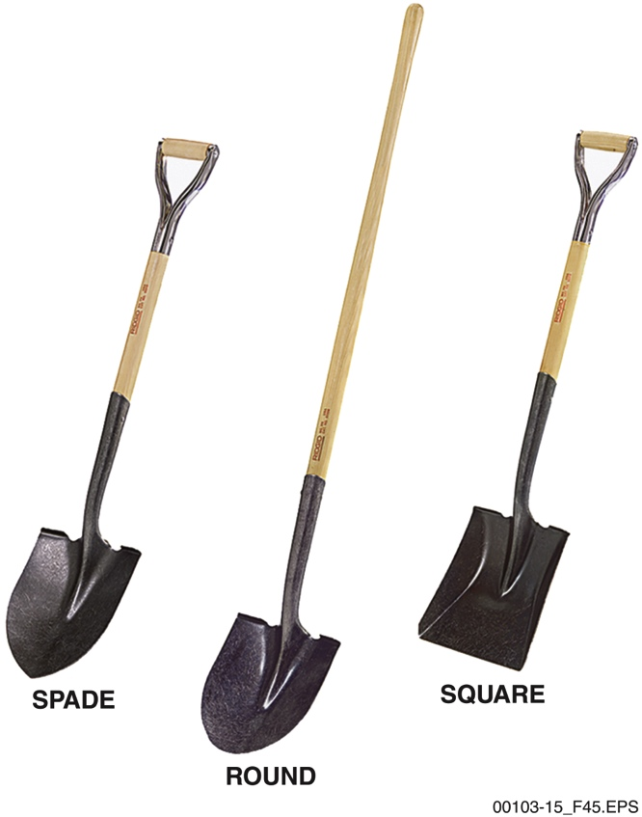
Section 4.1.0 – Earth Tools
Square shovels can hold a lot of material, but they do not dig well. They are best used for loose material collection, such as sand or gravel. Be aware of the load weight; wet material will be heavier and more difficult to control.
A pick is a good choice to break up rocky soil, while the mattock is better for clearing tree roots.
Notes:
Describe the shovel blade shapes and the uses for each shape. Discuss leverage. Explain how to choose the right shovel for the job and how to properly use it. Describe the characteristics and purposes of a pick. Use the figure to describe the differences between a pick and a mattock. Explain how to safely and properly use a pick.

Slide 10
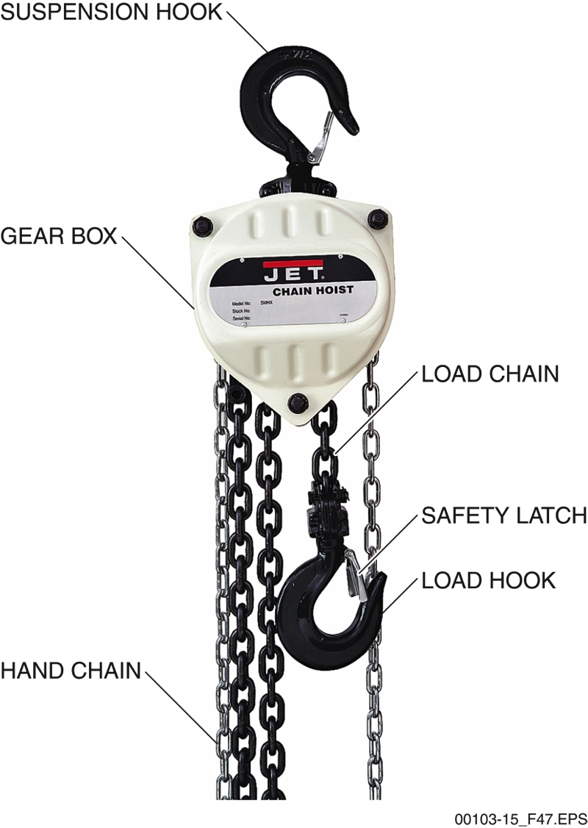
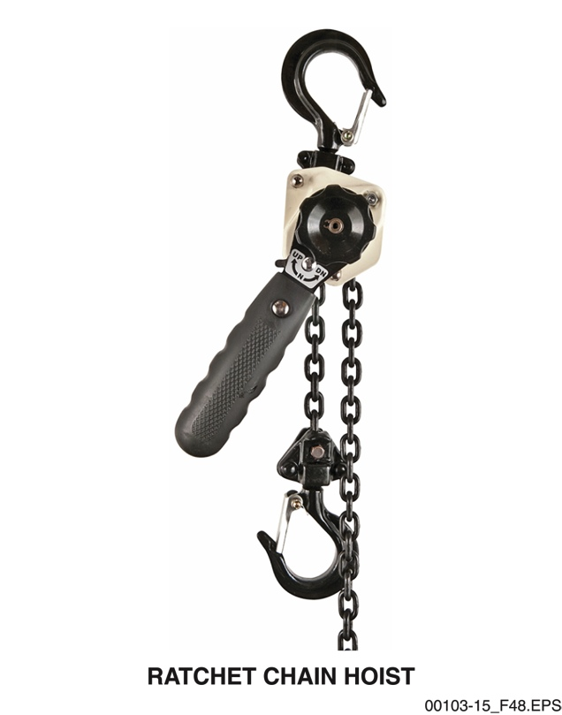
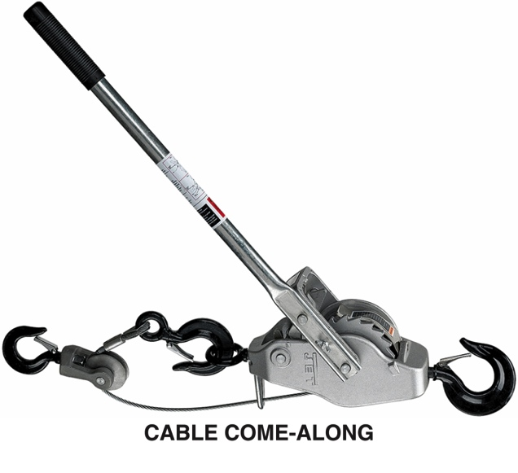
Sections 4.2.1 and 4.2.2
Chain falls are not fast, but they are reliable and can lift a significant amount of weight with very little physical effort.
Cable come-alongs are not typically safe for vertical lifting.
A ratchet chain hoist is a much better choice. However,
a cable come-along is more manageable than a
chain hoist for horizontal movement.
Notes:
Describe the components of a chain fall. Explain that the lifting power comes from a series of internal gears.
Compare and contrast come-alongs and ratchet chain hoists. Emphasize the limitations of a cable come-along and point out that they should not be used for vertical lifting.

Slide 11
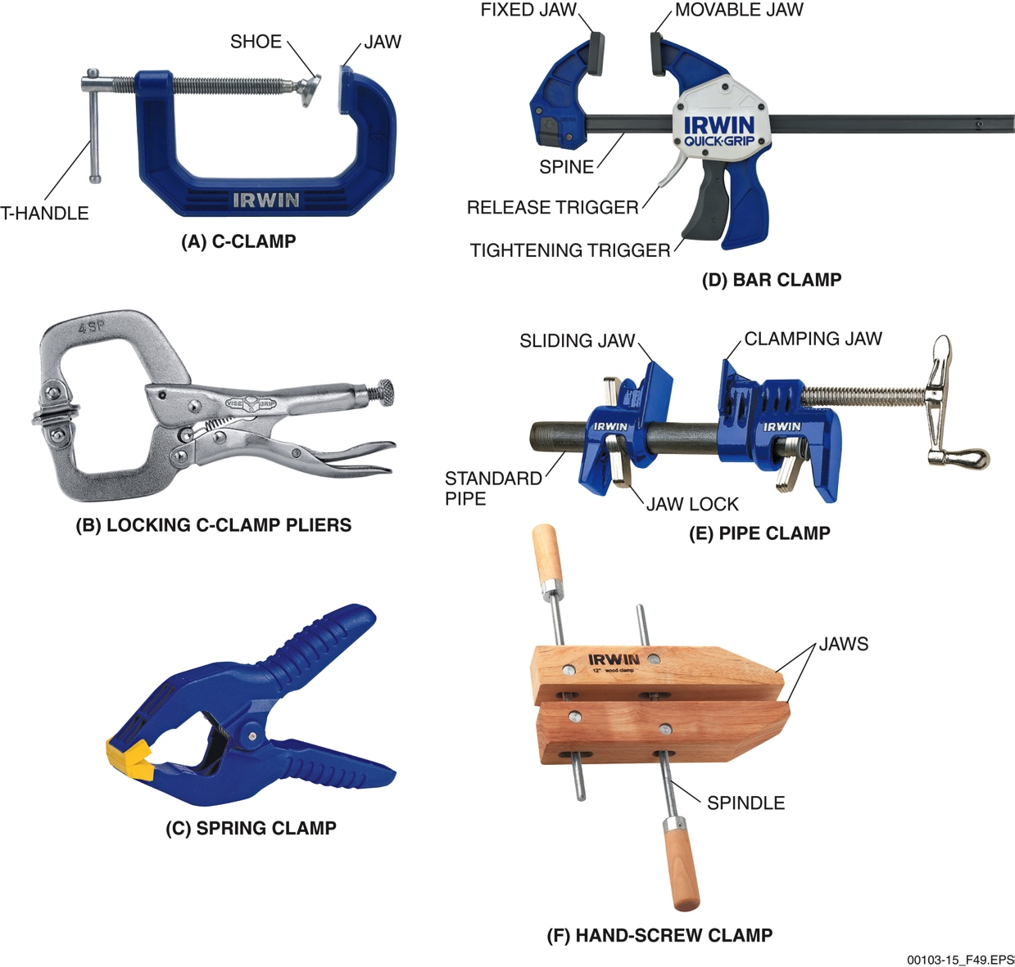
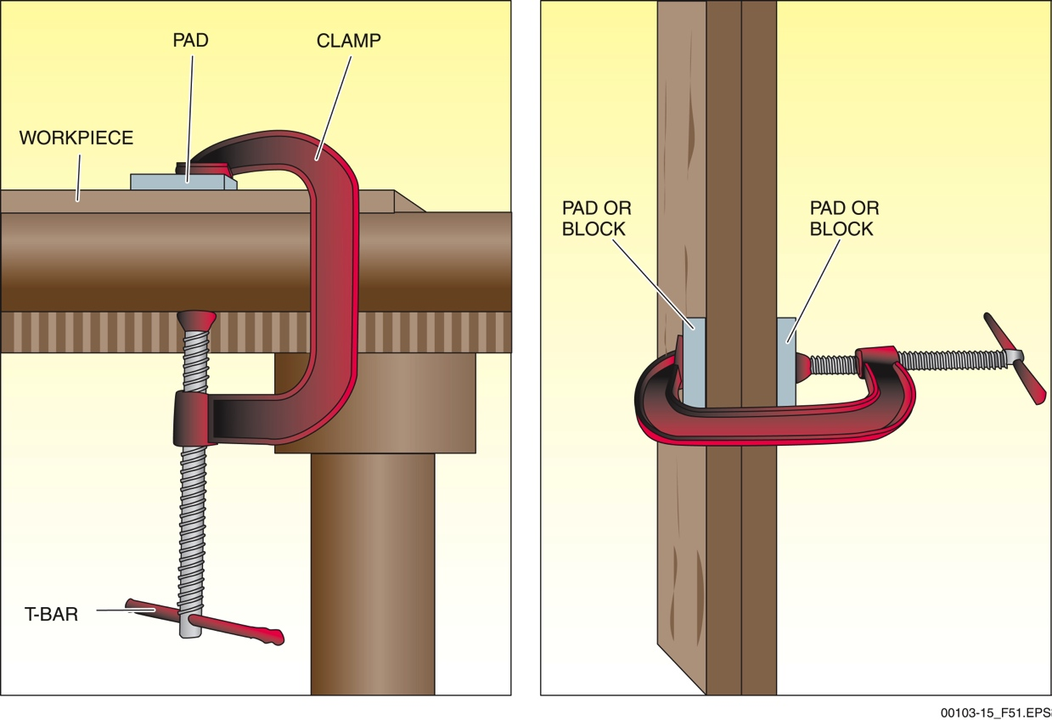
Section 4.3.0 – Clamps
A block of soft wood or a heavy rubber pad is often needed with clamps to prevent damage to the workpiece surface. This is especially important when working with exotic woods and similar materials.
Notes:
Describe the different types of clamps and their uses. Explain how they are sized. Review each of the different clamp types along with the figure provided. Emphasize the importance of protecting the workpiece from clamp damage.

Slide 12
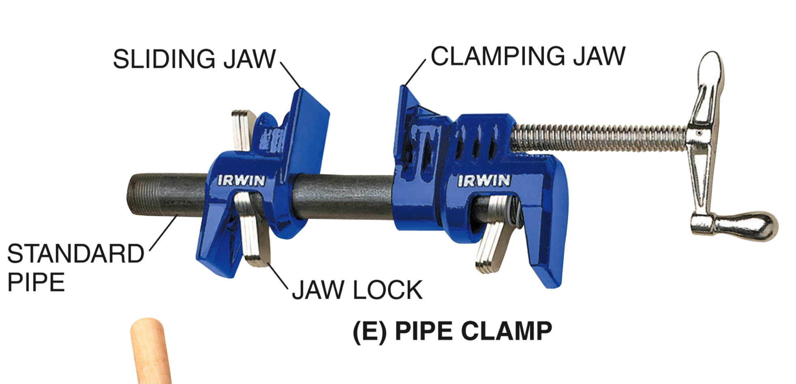
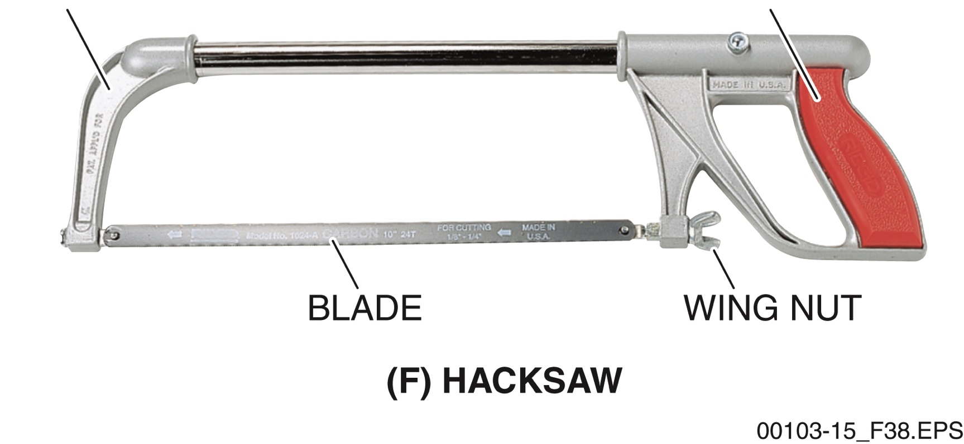
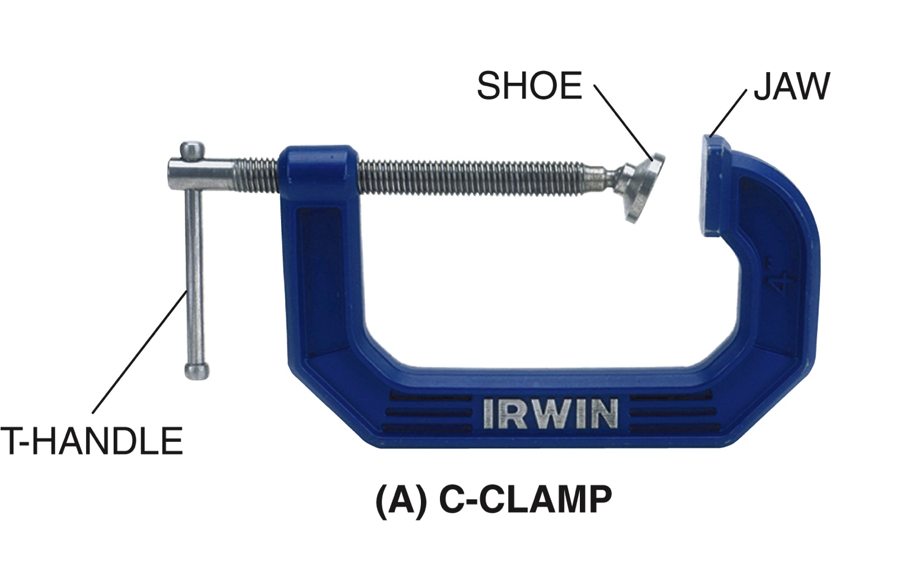
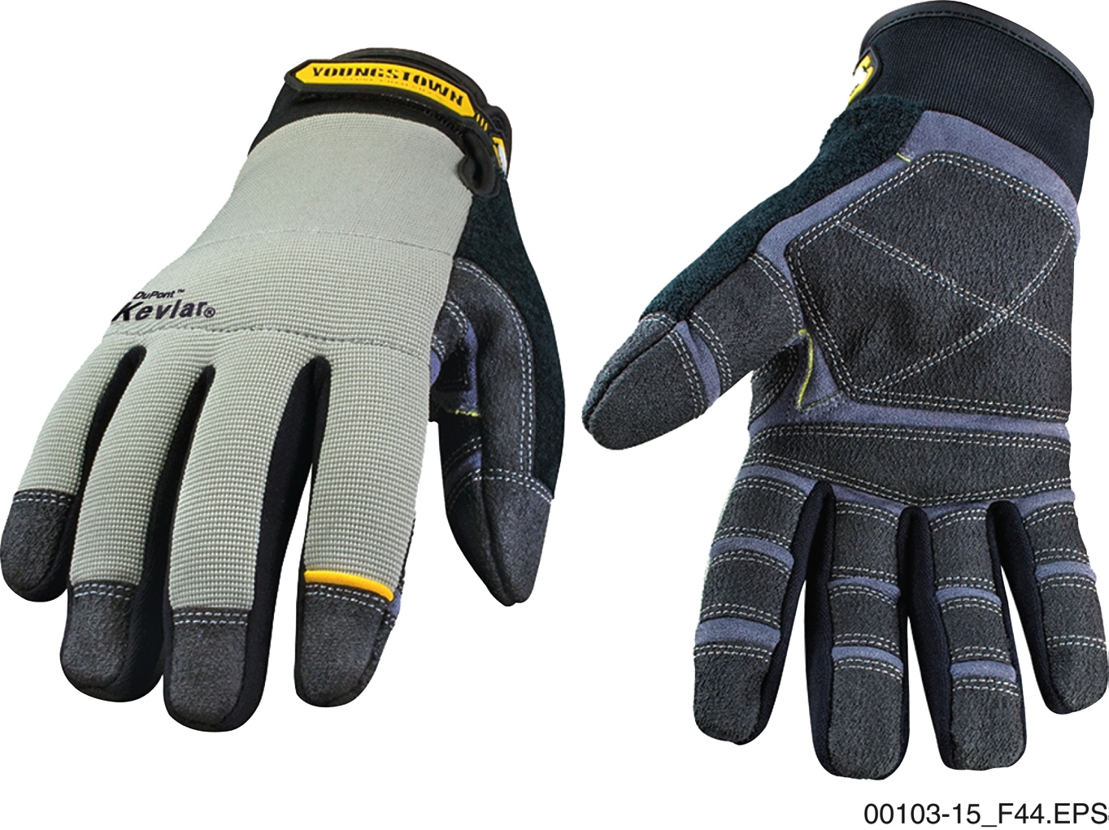
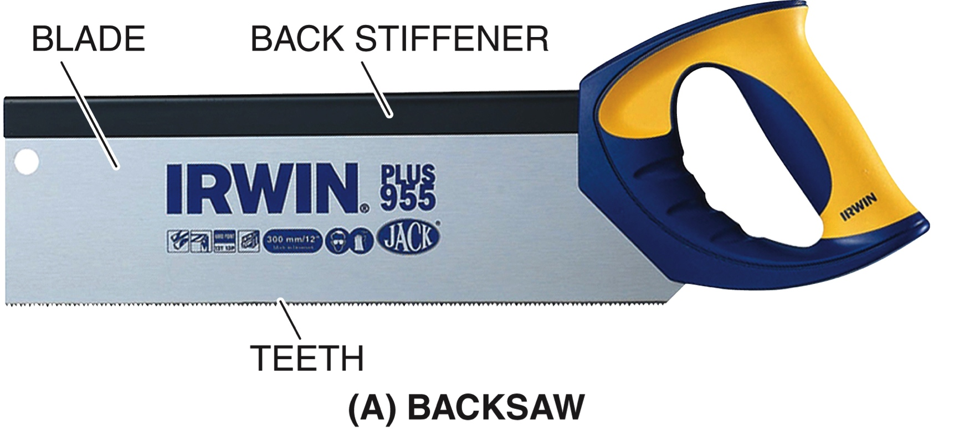
Wrap Up – Hand Tool Review
What Is It and How Do I Use It?
Hand tools from today’s session will be shown in random order. Name the tool accurately and completely, and then briefly show the instructor how to use it safely and properly.
Wrong name? The other team gets a chance to name and demonstrate use of the tool. Wrong instructions? The other team gets a chance to instruct and steal those two points.
Both name and instruction correct = 3 points
Name only correct = 1 point
File
?
?
?
?
?
Gloves
?
Notes:
Divide the trainees into teams. Use the prepared slides in the PowerPoint® presentation that will show some of the tools presented in this session in random order. The first team to accurately name the tool and provide instruction on its proper use gains three points. Incorrect answers or failure to show how the tool is used properly on the first attempt creates an opportunity for the opposing team. Consider a prize for the winning team.

Slide 13
Next Session…
LABORATORY:
USING HAND TOOLS
Review the complete module to prepare for the laboratory and Performance Tasks in the next session.

