Slide 2
Session 1: Identifying Construction Drawings and Drawing Components

Slide 3
Session One Objectives
Related Performance Task
Using the floor plan supplied with this module:
Locate the wall common to both interview rooms.
Determine the overall width of the structure studio.
Determine the distance from the outside east wall to the center of the beam in the structure studio.
Determine the elevation of the slab.
When trainees have completed this lesson, they should be able to do the following:
Identify and describe various types of construction drawings, including their fundamental components and features.
Identify various types of construction drawings.
Identify and describe the purpose of the five basic construction drawing components.
When trainees have completed this session, they should be able to do the following:
Identify and describe various types of construction drawings, including their fundamental components and features.
a. Identify various types of construction drawings.
b. Identify and describe the purpose of the five basic construction drawing components.

Slide 4
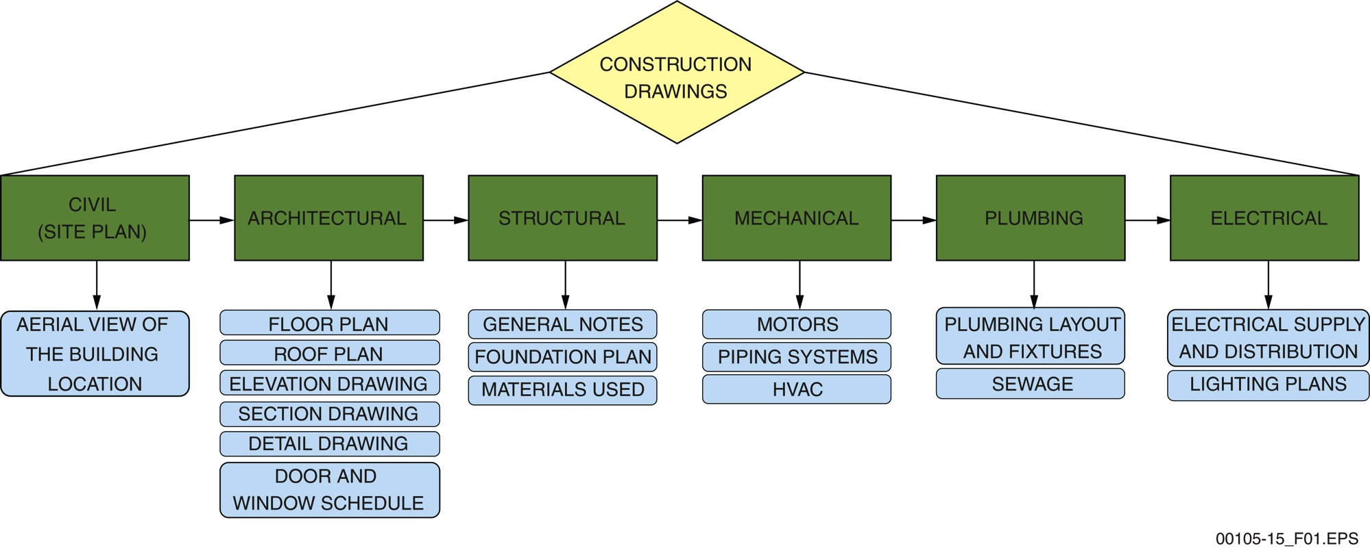
Section 1.1.0 – Drawing Types
These six drawing types are the most common types, although some buildings require other types as well.
Notes:
Review the figure and discuss the various categories of plans.

Slide 5
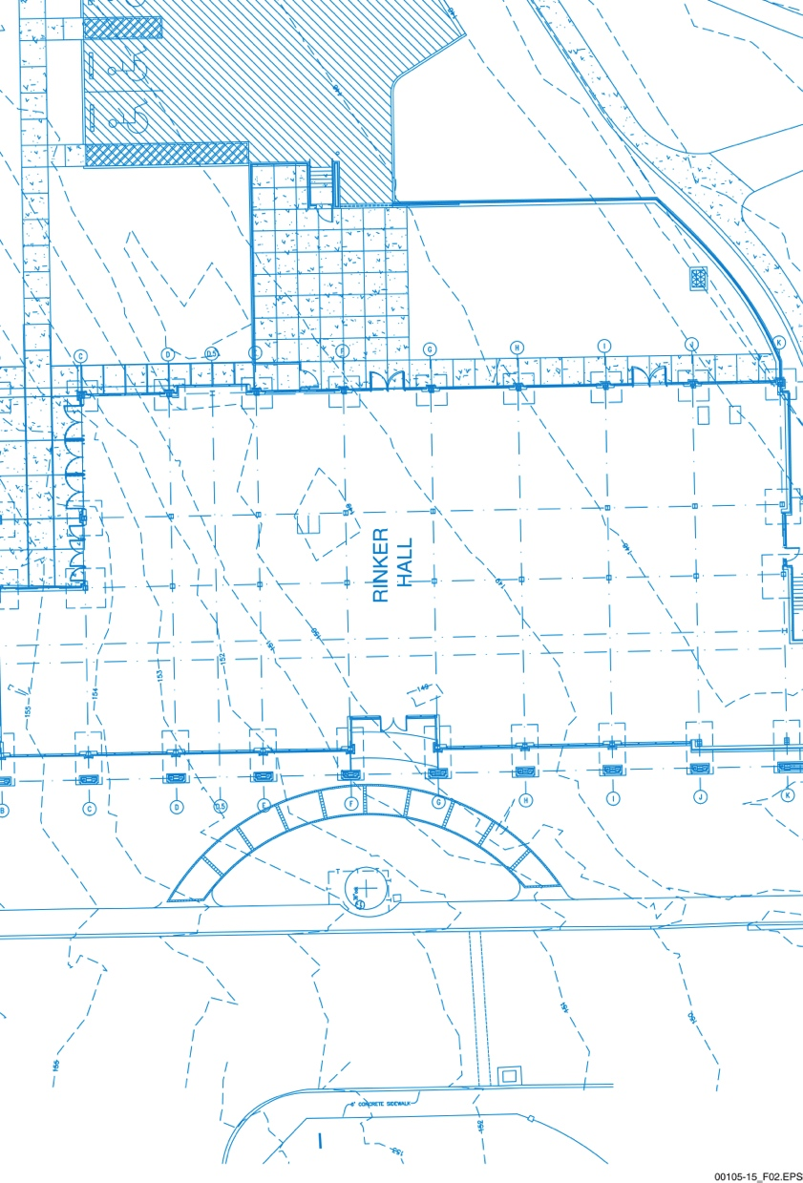
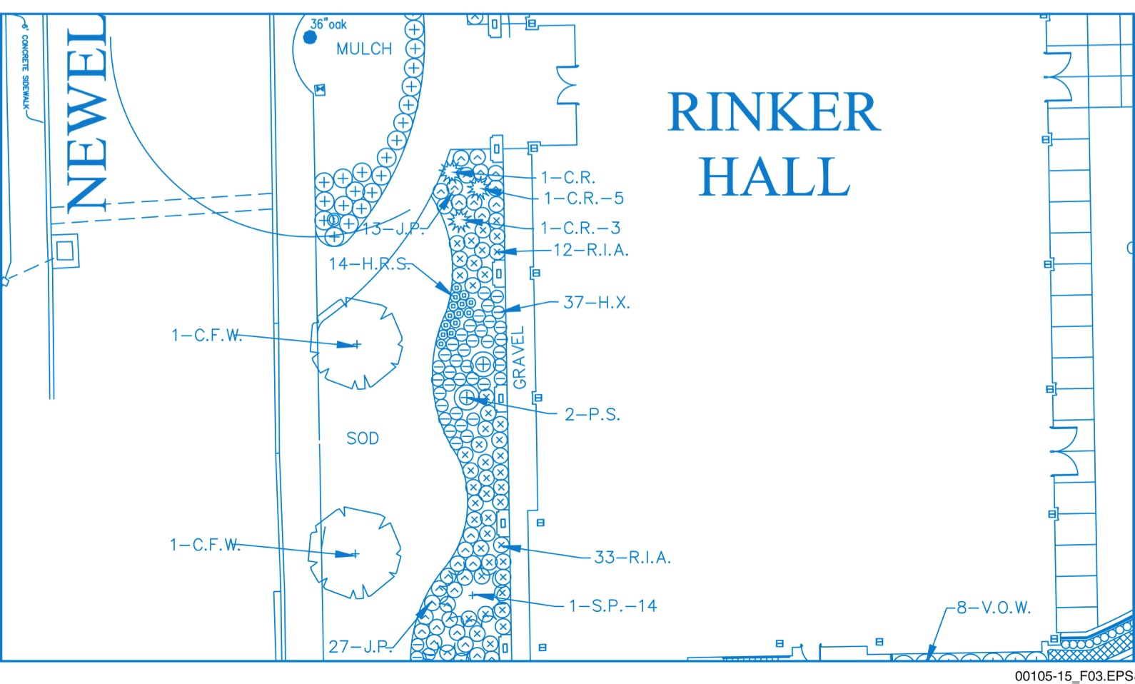
Section 1.1.1 – Civil Drawings
Civil drawings can cover a very large area, depending on the project.
Note the symbols used to identify specific plants in the landscaping plan. A legend is used to match each symbol to the specific plant.
Notes:
Explain that a site must be considered practical for a structure before construction can begin. Using the figure, point out the contour lines and explain their purpose. Discuss the information found on a landscape plan.

Slide 6
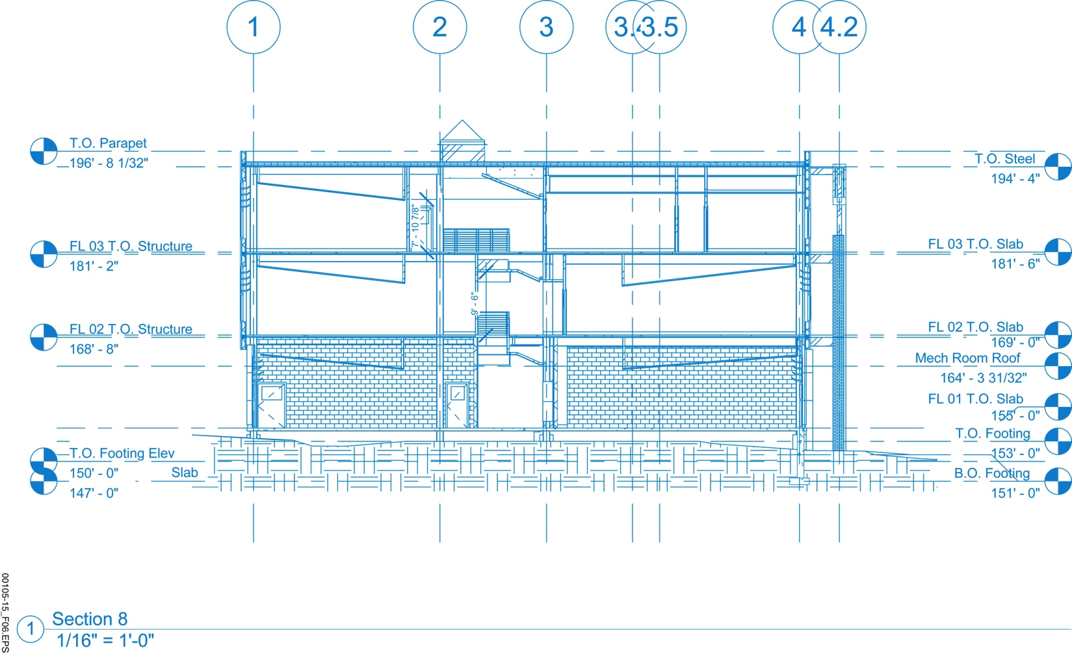
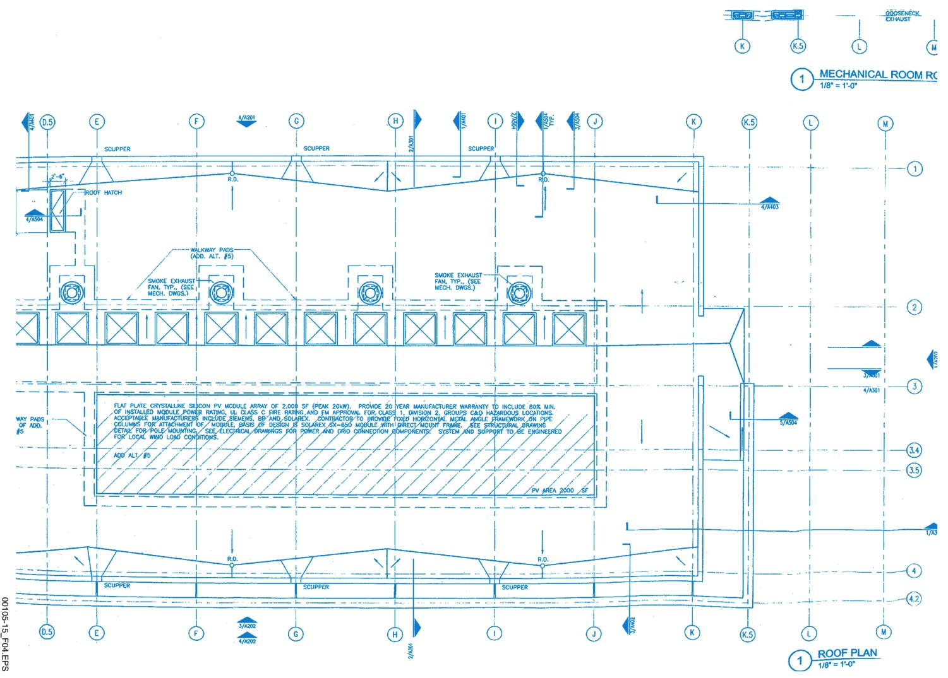
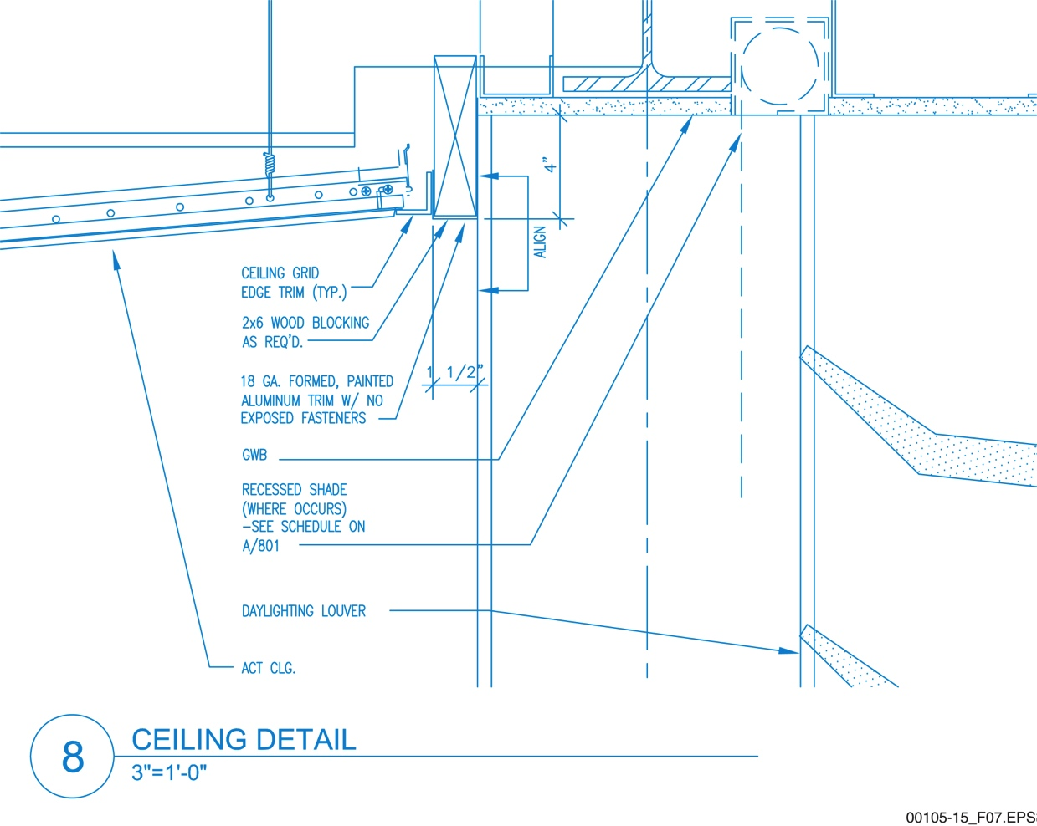
Section 1.1.2 – Architectural Drawings
…and detail drawings are just a few of the architectural drawings you will encounter.
Roof drawings…
…elevations, …
Notes:
Explain that there are various types of architectural plans. Discuss the components of the roof plan. Using the figure, point out the elements of an exterior elevation plan. Display the figure of the section drawing and compare the information contained in the exterior elevation figure. Define a detail drawing and describe where they can often be found.

Slide 7
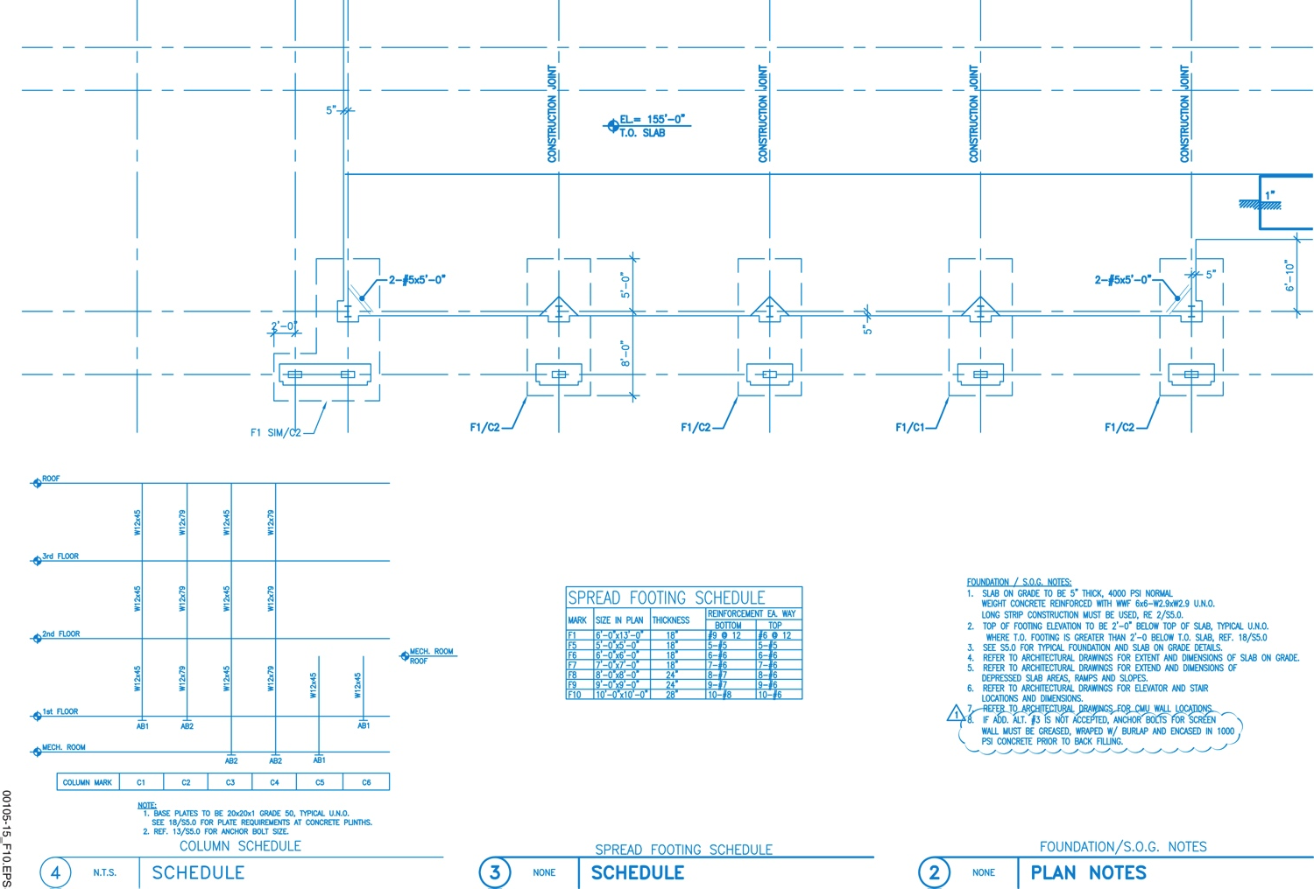
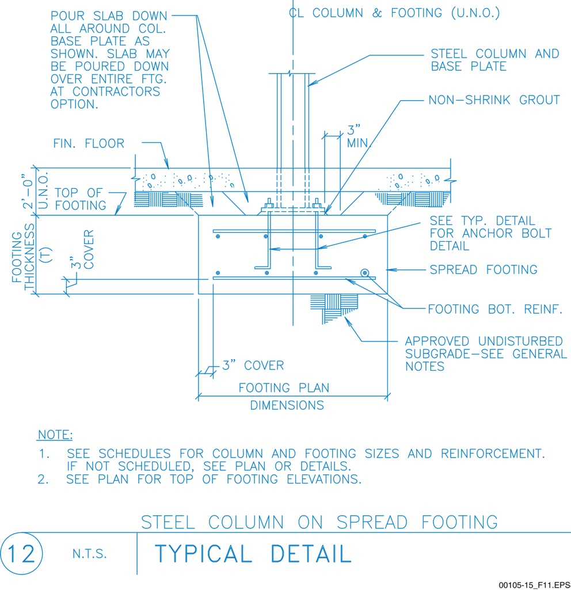
Section 1.1.3 – Structural Drawings
A foundation plan shows the footings for this building.
Detail drawings may be needed in all six drawing types to show precisely how components should fit together.
Notes:
Describe the information found on a foundation plan. Have trainees refer to Drawing 2, Roof Framing Plan, in the drawing package as you talk about the information found on this type of drawing. Talk about the various building elements that are part of its supportive structure and are therefore part of the structural drawing package.

Slide 8
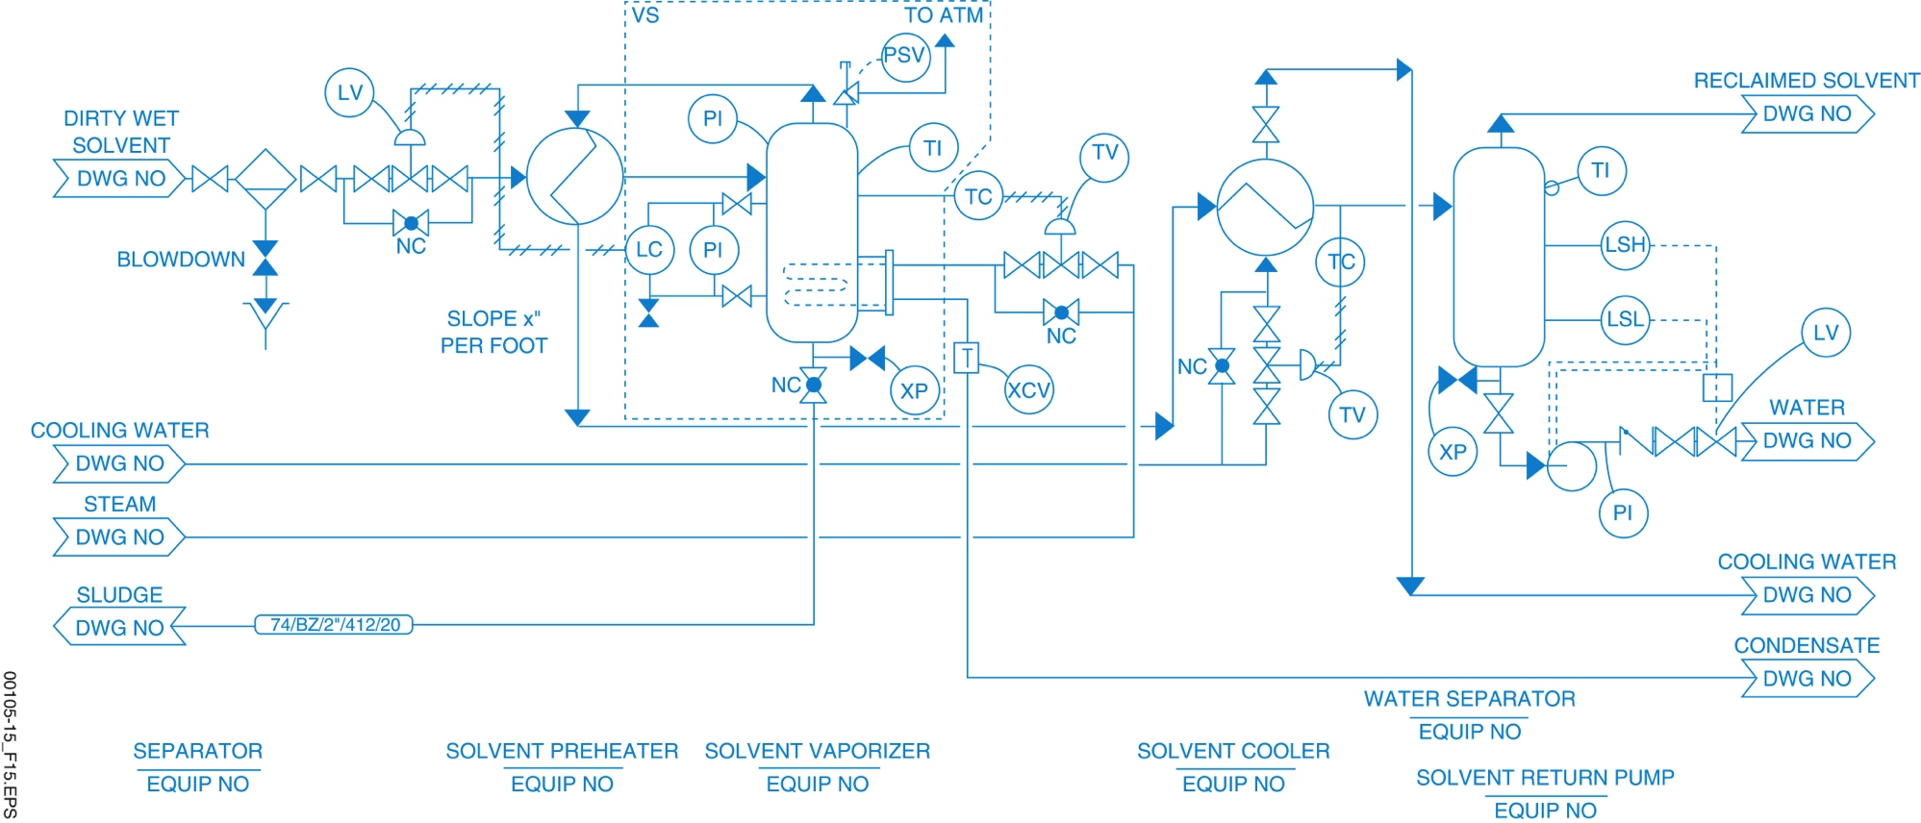
Section 1.1.4 – Mechanical Plans
Mechanical plans can include P&ID drawings that show complex processes and the operating relationship of components without showing exactly where things are physically placed on the site.
Notes:
Explain the purpose of mechanical plans. Review the information found on a mechanical legend and list of abbreviations. Explain the purpose and content of P&IDs. Point out they are not drawn to scale and do not indicate compass directions. Discuss what information HVAC plans provide. Present the HVAC drawings and discuss the information they contain. Discuss the information provided by a mechanical detail drawing.

Slide 9
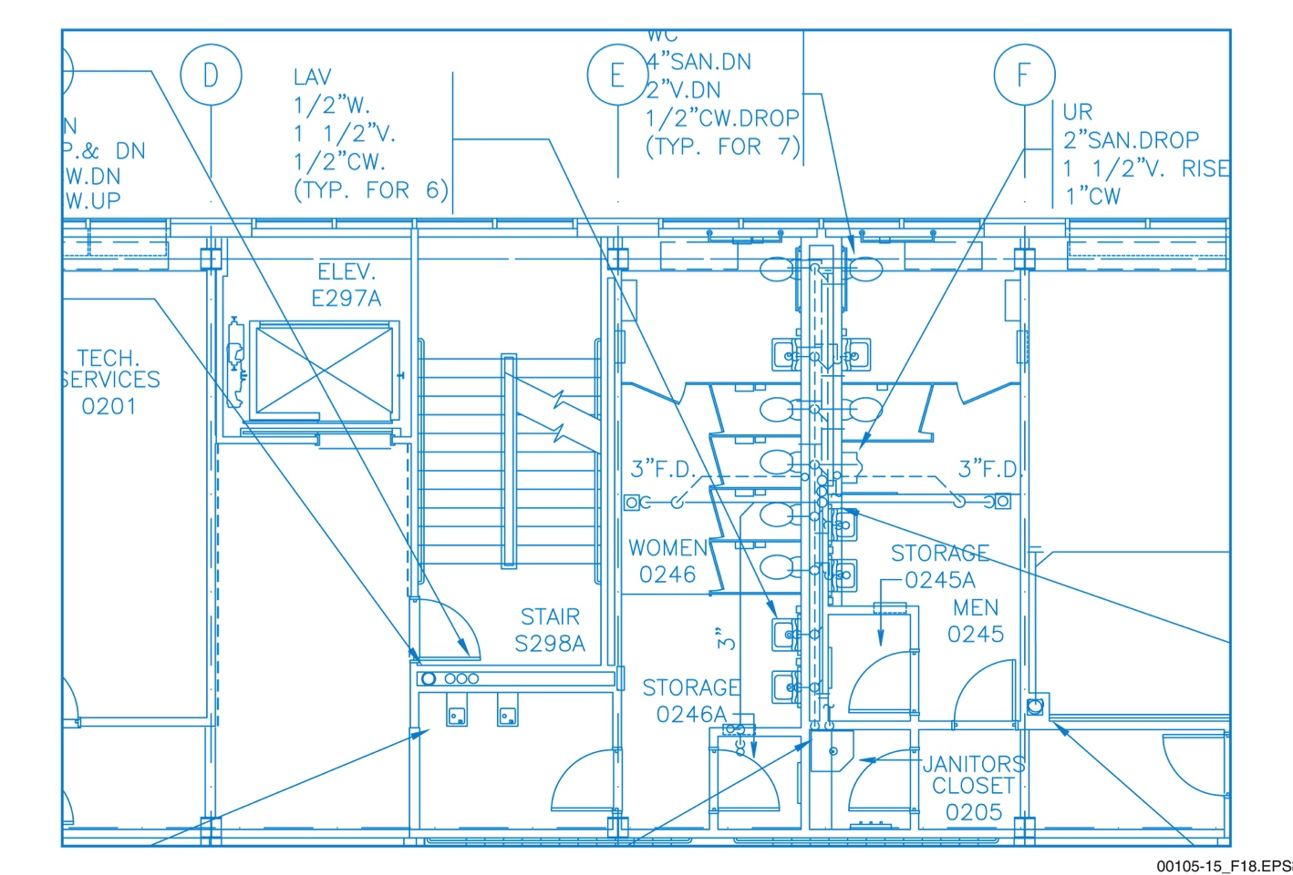
Section 1.1.5 – Plumbing Drawings
The plumbing plan focuses on potable water distribution, sanitary and sewage disposal, and fixtures such as sinks and toilets.
Notes:
Discuss the information found on plumbing plans. Explain how plumbing isometric drawings work in conjunction with other plumbing plans.

Slide 10
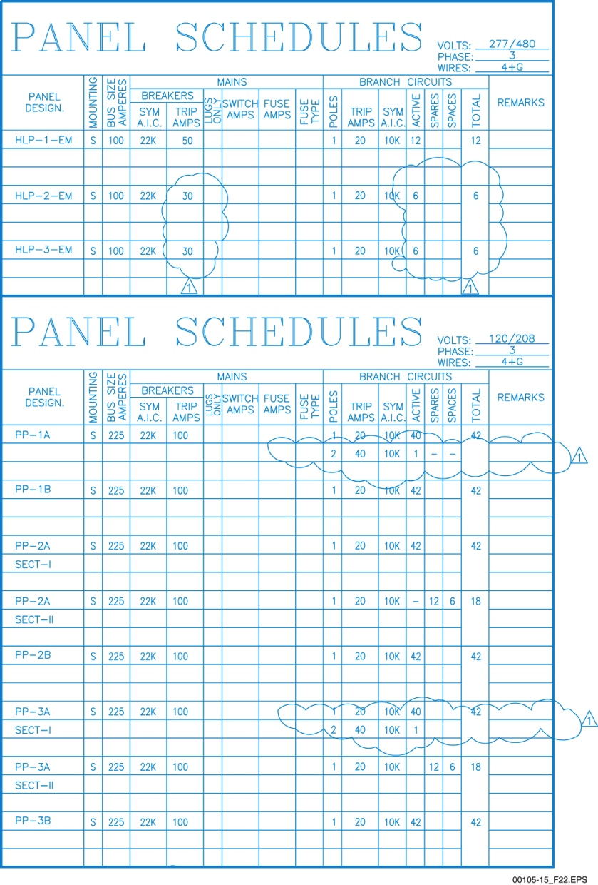
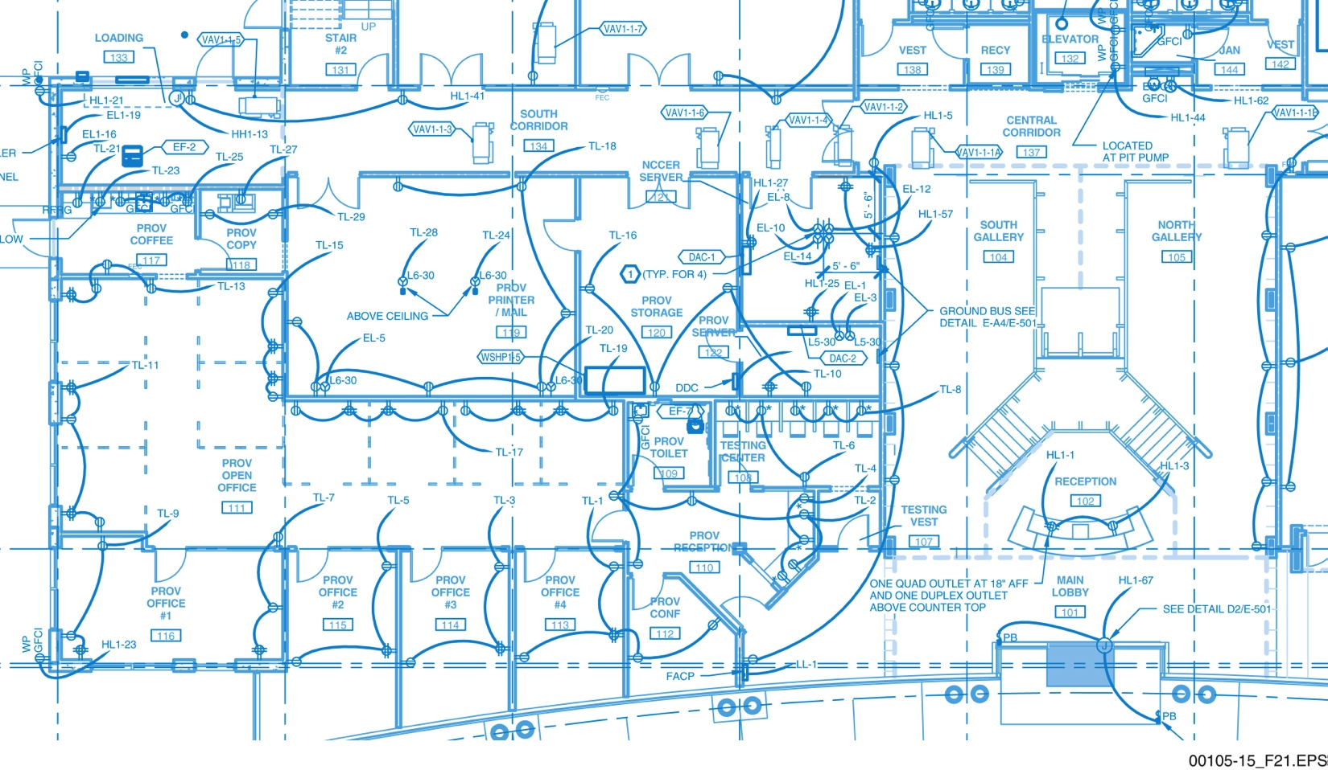
Section 1.1.6 – Electrical Plans
Power plans show how power is distributed…
… while a panel schedule identifies each circuit breaker position and its electrical capacity.
Notes:
Describe the contents of electrical plans. Discuss when separate plans are used and describe their level of detail. Point out the information found in the general notes. Use the figures to show the information found on lighting, power, and panel plans. Review the information found on an electrical legend and electrical list of abbreviations.

Slide 11
Section 1.2.1 – Title Block
Title blocks usually contain:
Company logo
Sheet title
Dates
Draftsperson identification
Drawing number
Scale
Revision blocks
In addition, the title block area may be used like a business card, listing office addresses and similar information.
Notes:
Point out the location of the title block and what it contains. Review the contents of a typical title block. Point out that title blocks may differ somewhat from company to company.

Slide 12
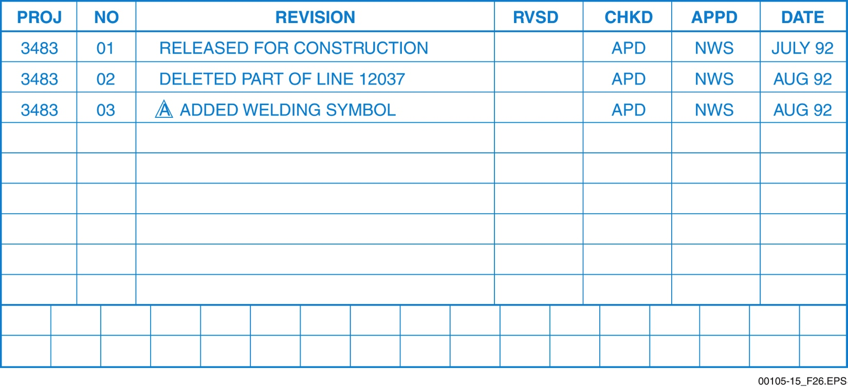
Section 1.2.4 – Revision Block
It is essential that craftworkers use the latest revision. A very small change in one place can make a big difference somewhere else.
Notes:
Discuss the purpose of a revision block. Emphasize that the current revision must always be used. Ask the trainees to give examples of how using an earlier revision could affect the project.

Slide 13
Wrap Up – Trade Terms
Architectural plans
Drawings that show the design of the project. Also called architectural drawings.
Beam
A large, horizontal structural member made of concrete, steel, stone, wood, or other structural material to provide support above a large opening.
Blueprints
The traditional name used to describe construction drawings.
Civil plans
Drawings that show the location of the building on the site from an aerial view, including contours, trees, construction features, and dimensions.
Computer-aided drafting (CAD)
The making of a set of construction drawings with the aid of a computer.
Contour lines
Solid or dashed lines showing the elevation of the earth on a civil drawing.
Fire protection plan
A drawing that shows the details of the building’s sprinkler system.
Floor plan
A drawing that provides an aerial view of the layout of each room.
Foundation plan
A drawing that shows the layout and elevation of the building foundation.
HVAC
Heating, ventilating, and air conditioning.
Detail drawings
Enlarged views of part of a drawing used to show an area more clearly.
Electrical plans
Engineered drawings that show all electrical supply and distribution.
Elevation (EL)
Height above sea level, or other defined surface, usually expressed in feet or meters.
Elevation drawing
Side view of a building or object, showing height and width.
Legend
A description of the symbols and abbreviations used in a set of drawings.
Mechanical plans
Engineered drawings that show the mechanical systems, such as motors and piping.
Piping and instrumentation drawings (P&IDs)
Schematic diagrams of a complete piping system.
Plumbing isometric drawing
A type of three-dimensional drawing that depicts a plumbing system.
Plumbing plans
Engineered drawings that show the layout for the plumbing system.
Roof plan
A drawing of the view of the roof from above the building.
Scale
The ratio between the size of a drawing of an object and the size of the actual object.
Schematic
A one-line drawing showing the flow path for electrical circuitry or the relationship of all parts of a system.
Section drawing
A cross-sectional view of a specific location, showing the inside of an object or building.
Specifications
Precise written presentation of the details of a plan.
Structural plans
A set of engineered drawings used to support the architectural design.
Symbol
A drawing that represents a material or component on a plan.
Title block
A part of a drawing sheet that includes some general information about the project.
Notes:
Review the Trade Terms covered in today’s session. Each definition will appear on the accompanying PowerPoint® slide. Have the trainees provide the proper term for each definition. The terms will appear one at a time as you advance the presentation.

Slide 14
Next Session…
IDENTIFYING DRAWING ELEMENTS; DIMENSIONS AND DRAWING SCALES; USING SCALES
Read Sections 1.3.0 through 1.5.3. Complete the Section 1.0.0 Review.

